Slide 1

The Edinburgh Multi Access System (EMAS)
Bob Eager
20th March 2025
http://emas.bobeager.uk

Slide 2
Introduction
  Some basic information about the Edinburgh Multi-Access System (EMAS)
    What?
      An efficient multi-access system offering interactive and batch facilities on ICL and IBM (+clone) mainframes
    When?
      From 1970 to 1992 (predecessor/development between 1966 and 1970)
    Where?
      Mostly the University of Edinburgh, also the University of Kent
    Who?
      Developed at University of Edinburgh by Department of Computer Science and Edinburgh Regional Computing Centre; Kent work by Bob Eager
3

Slide 3
Part I - History
1966 saw the foundation of the Edinburgh Regional Computing Centre; in December, a rented KDF9 was delivered to provide a service; significantly, it supported Atlas Autocode
In the same year, a large team (Edinburgh and ICL) started the Edinburgh Multi Access Project, to write a multi access system for the English Electric Leo Marconi System 4/75 (the most powerful system in their range); the team was led by Harry Whitfield but was really an ICL model
It included managers, team leaders, designers, 25 programmers, also technical and coordinating committees
A language called IMP was developed as an implementation language
  Very similar to Atlas Autocode
The System 4/75 was delivered in December 1968/June 1969, and the KDF9 was removed shortly afterwards; only a batch service was offered
EMAP development did not go well, and the project was abandoned in September 1970, as it did not meet expectations
1

Slide 4
This was the start of the internal EMAS project, salvaging some of the work, with a team of between 3 and 7 people
A pilot EMAS service was running within a year, and a formal EMAS service started in October 1972, although it quickly became overloaded
Replacement with an IBM system was not permitted, so it was to be one of the New Range machines from ICL (a 2980), and it had to be running VME/B
The 2980 was delayed by a year, so ICL provided a temporary system; this was an ICL 2970 (about 30% of the power of a 2980), with a smaller memory (1MB); running VME/B, this supported a batch system and 1-2 (!) interactive users
At this point, the EMAS team looked at the feasibility of implementing EMAS on the ICL 2970
  … but with network communications instead of large multiplexers
  It would use a PDP-11 as a front end to the rest of the growing network
The 2900 series was a good architecture for high level languages such as IMP, in which the system would naturally be implemented (IBM architecture was not built for stacks)
1

Slide 5
They did it! There are papers about it, notably one entitled:
  An Experiment In Doing It Again, But Very Well This Time
  The system was called EMAS 2900, but later was also known as EMAS-2
A pilot service worked well, and supported 30 terminals on a 1MB machine
  ICL donated the 2970 to ERCC
A full service was offered on the 2970 from October 1978
Meanwhile, in April 1978, the University of Kent installed a copy of EMAS in order to perform trials (see later)
  Their 2960 was roughly half the power of the 2970, but had 2MB of memory
1

Slide 6
By October 1978, the 2980 (running VME/B) had failed to meet its benchmark, although reliability had improved (not perfect)
  The system was then adopted for regional service
  A year later, it was clear that the 2980 service was inadequate
  It was decided to switch it to EMAS, and this happened in January 1980 (two weeks after Kent had done the same)
Over the next few years there were various upgrades from ICL
In 1984, an Amdahl 470/V7 was delivered
  IBM mainframe clone, but with some changes
By the spring of 1985, this too was running a re-implemented EMAS, known as EMAS-3
  This ran for several years
By mid-1988, the EMAS-3 service had been moved to an (Itel, NAS, HITACHI) AS/VL-80
  Large, powerful system with 8 front end PDP-11/73s
In June 1992, the final EMAS-3 service was shut down
2

Slide 7
Timeline
The project spanned 26 years
User service spanned 22 years
The Kent service spanned 7 years (on 2900 only)
Apart from the EMAP era, the development team was always small
1

Slide 8
Part II – University of Kent
From 1969 to 1976, Kent ran the Kent Online Service (KOS) on (initially) one Elliott 4130 with 64kW/96kW of memory
  A second 4130 was added around 1974
  This service mainly provided BASIC for teaching, with some editing and other utilities, plus a substantial batch service
In 1976, these were replaced with an ICL 2960 running VME/K
This was very unreliable; MTBF (combined hardware and software) around 20 hours
  System fixes were received via badly Xeroxed hexadecimal patches
  In the early days, 200 bug reports were submitted in a single month
The system was not very user friendly (3 commands needed to copy a file)
18 months later, ICL proposed to re-engineer VME/K, but would remove some features which were essential to the Kent workload
It was time to investigate alternatives
1

Slide 9
In April 1978, Peter Stephens, from Edinburgh, installed EMAS one evening, finishing in time for dinner!
Bob Eager was the sole contact and systems person for EMAS itself
  Others handled networking and applications
Early testing showed a lock up in the EMAS Director (q.v.)
  Traced to a bug which only showed up with numerous registered users (more than Edinburgh)
  Fixed within hours
The system was inexplicably a lot slower than expected
  This was traced to a hardware incompatibility with the way things were done on other machines (2970, 2980) in the range
  A software fix was applied at the operator console, on the running system!
There were hardware (parity) errors on the link to the PDP-11/34 front end
  This was traced to an earthing problem, due to the 2960 and 11/34 being on different power feeds
  Fixed (probably with an earthing braid)
3

Slide 10
The Kent network was based on a Cambridge ring
  Differences were all handled inside the front-end processor
User trials were run every day for two hours
The changeover took place after the end of term in December 1979, and there was no going back
  A utility was written to transfer users and files from the VME/K disks
The MTBF went from 20 hours to around 2000 hours
  EMAS was more resilient to hardware faults (particularly disk controller crashes)
Initial distrust from ICL engineers, after which they were very much on board
A serious problem in 1982 (microcode crash) turned out to be a hardware design error
  Fixed by Bob Eager with a hand-crafted microcode patch!
1

Slide 11
In summer 1983, a second OCP (CPU) was acquired from Government sources (1981 census) for the cost of transport (~£350)
  More memory was added (to 4MB)
It worked straight away, but cross reporting between OCPs did not work
  Another range incompatibility
  Documentation from ICL was not forthcoming, and it was not known what bits had to be poked where!
Solved by Bob reverse engineering the microcode to work out where and what those bits were
  System modified to correct the cross reporting
The service ran very successfully until shutdown in 1986
Kent contributions:
  Various system enhancements, such as printer accounting
  Applications: BASIC, assembler, BCPL, some packages, another editor
1

Slide 12
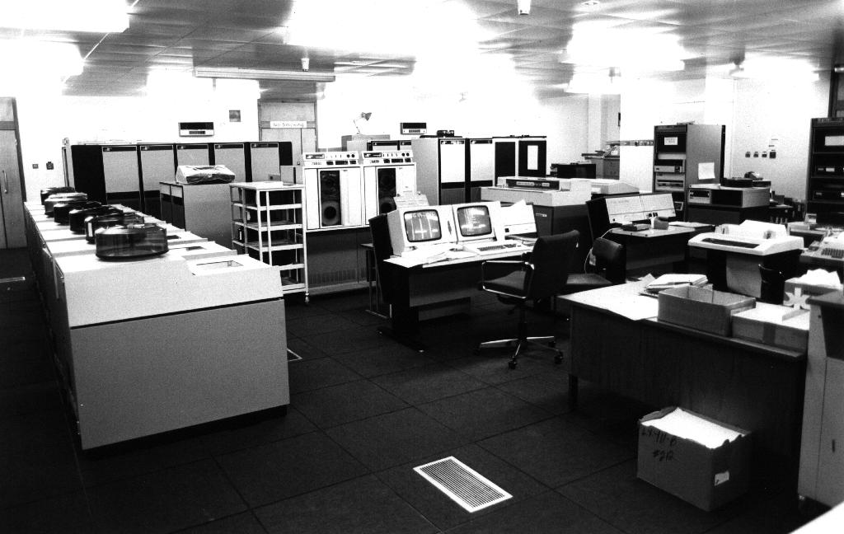
Kent 2960 circa 1981

Slide 13
Part III - Implementation
Limited here mainly to the 2900 implementation, because:
  4/75 version (EMAS-1) was continually developed, and no sources are available
  IBM/Amdahl/NAS (EMAS-3) based on EMAS 2900 anyway; incomplete sources available
  2900 sources are almost complete
Information taken from papers and manuals, also from extensive reading of the source code!

Slide 14
Files and paging
Files are accessed by connecting them into the virtual memory of a process; the user accesses them as if they are part of main storage
  Connection is merely a book-keeping operation
  There is no need for primitives such as read, write, or seek
Files are divided into pages of fixed size; a page of a file is only actually brought into memory if it is referenced (either as code or data)
Changed pages are automatically written back to disk when the memory is needed for something else, or on file disconnection
Files can be shared by two or more processes, with only one copy of an active page being kept in memory
  Code is thus automatically shared
  File data (‘buffers’) can also be shared if a file has multiple users

Slide 15
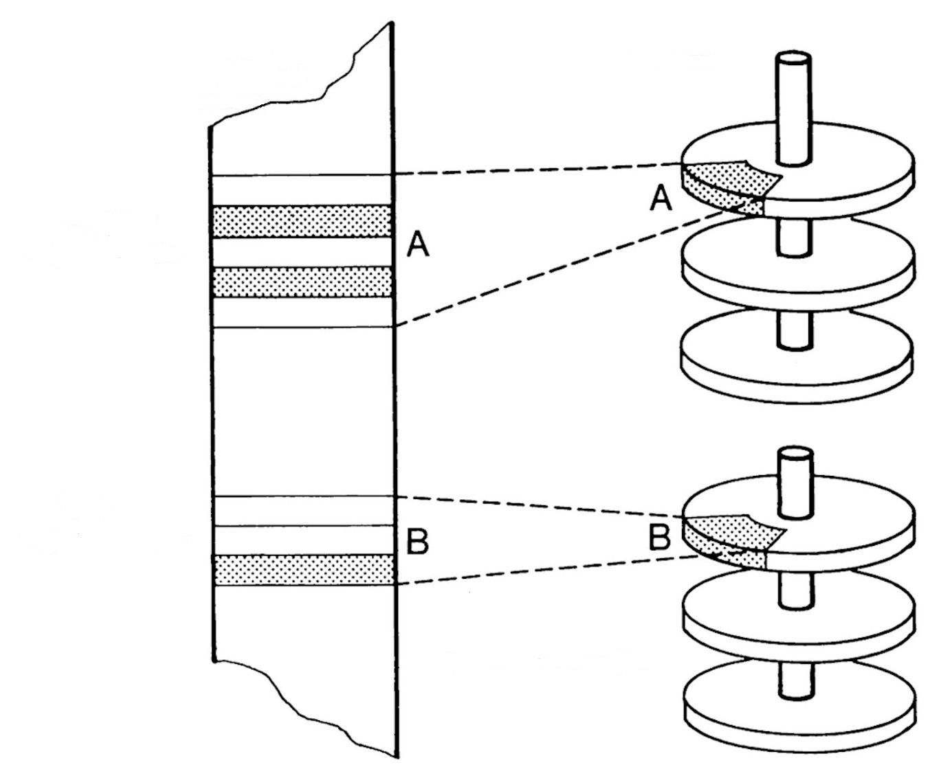
File Mapping
Part of a user’s virtual memory
User access to file A
Mappings
User access to file B
Disk storage

Slide 16
The Kernel
The system uses a small message passing kernel
Messages are always 32 bytes, and are allocated from an expandable pool
  4-byte source, 4-byte destination, 24-byte payload
Non-paged system processes include:
  Device drivers
  Paging manager
  Semaphore implementation
  Active memory handler
  Scheduler
  Interval timer and real time clock handler
  Configuration control
  Bulk storage mover (disk to disk, disk to tape, tape to disk)
These are collectively known as the global controller
  One instance per OCP (CPU)
2

Slide 17
Process structure
Every non-resident process includes an instance of the local controller (q.v.), which is nonetheless resident, with shared code; it is privileged
  Each process has its own local controller data and stack, although these are paged
The privileged, but paged, portion of each non-resident process is supplied by the Director, again with shared code and per-process data and stack
The non-privileged part of each process can vary, and is supplied by a basefile, connected in its virtual memory
  This is all paged
The standard basefile is the Edinburgh Subsystem, which provides the normal user interface
  Users can supply their own basefile if desired
Other basefiles exist, for example the Scientific Jobber (a fast batch compile/run system for student work)
1

Slide 18
Other processes
Paged system processes provide various services:
  DIRECT – operator control, logon, process start-up and other functions
  VOLUMS – tape administration (also backup and archive)
  SPOOLR – input and output spooling (local and remote)
  FTRANS – file transfer (‘Blue Book’)
  MAILER – electronic mail (‘Grey Book’)
These all operate as user processes (for privileged users) with a specialised basefile (except DIRECT, which has no basefile)

Slide 19
The Local Controller
The local controller is a resident part of each paged process, and (inter alia) handles paging strategy for that process (the global controller is responsible for the paging mechanism)
Each process is allocated a page quota, which must not be exceeded; the quota changes over time according to process behaviour; enforced by the local controller
Any ‘thrashing’ is thus local to one process; if it occurs, the process is rescheduled with more pages, and a different CPU profile
  The algorithm is table driven, and easily changed
  Batch processes effectively use a different table, with more emphasis on throughput and less on response time
Each process is responsible for its own page replacement policy
The quota system ignores page sharing, so memory can be under-used; solved by overcommitting (with tuned recovery in the event of deadlock)
1

Slide 20
The Director
The Director is part of all paged processes, but has private data and stack for each process
It implements:
  File system code and data
  System calls (passed to local controller via hardware call)
  Contingency (exception) handling
  Functions for the DIRECT process
The Director is where the ‘security border’ is located; it runs at a less privileged level than the Local Controller, but is more privileged than ‘userland’
The DIRECT process is unique in that it has no basefile; all of its code is inside the Director
It is mainly responsible for operator interactions, as well as validating user logons, process start-up and other miscellaneous functions
1

Slide 21
File System Primitives (provided by Director)
CONNECT – connect file in virtual memory
DISCONNECT – disconnect file, write back pages
CREATE – create a new file
DESTROY – destroy a file
RENAME – rename a file
PERMIT – change permissions for a file
GIVE FILENAMES – return names of files
OFFER – offer a file to another user
ACCEPT – accept an OFFERed file (disappears from donor)
NEWGEN – overwrite a file with a newer version, even if in use; existing users retain the old file until disconnected

Slide 22
The Subsystem
The subsystem is the ‘user’ part of a process; the basefile used by typical users of the system
The usual subsystem is the Edinburgh Subsystem, but others can be built
Runs in user (untrusted) mode
  Mostly accessed by an interactive terminal
  Can be used in batch, and there is a batch command language for job control
A single process model is used (unlike, say, UNIX)
Users can install additional commands from public files, or write and install their own for individual use

Slide 23
Typical commands:
  ANALYSE – give type specific information about a file
  ALIAS – define alias for a command
  ARCHIVE – queue file for archiving and removal from disk
  OBEY – run a command script
  FILES – list files in current directory
  EDIT – edit a file (one of several editors)
  COPY – copy a file
  OPTION – set process options
  CHERISH – mark file as ‘precious’
    Will be backed up
    Will be archived after four weeks of non-use (otherwise just deleted!)
  OFFER, ACCEPT, PERMIT, RENAME, DESTROY, etc. – see calls to Director

Slide 24
Files are just arrays of bytes, but the Subsystem suggests a minimal amount of information, and in practice this convention is almost always obeyed
Files have a 32 byte header containing file type, date and time, physical size, logical size, record structure (if any) and pointers to other information such as object file data
Basic ‘partitioned’ files store multiple files in one place; files can be copied freely into, and out of, partitioned files
Subdirectories can also be created and used

Slide 25
System Structure
System paged processes
User processes (all paged)
Process 1 (DIRECT) has no basefile
Process 2
code and data
●
●
●
●
●
●
Process n-1
code and data
Process n
code and data
Collectively known as the Supervisor
Director 1
Director 2
Director n-1
Director n
PAGED
●
●
●
●
●
●
data
data
data
data
data
code
code
code
code
code
NON-PAGED
Communi-cations controller
Local controller 1
Local controller 2
Local controller n-1
Local controller n
Global controller (composed of non-paged processes)
8

Slide 26
The Communications Controller
The Communications Controller is a special version of the Local Controller, with its own page allocation
It has no associated Director or basefile
All I/O is from and to (parts of) files, which are connected (and paged in) as required
I/O for terminals is via two terminal buffers, which are in a single one-page file
This is mapped into the memory of the user process, and into the communications controller, as necessary

Slide 27
Initial Program Load (IPL, or boot)
The boot program is large, and contains device drivers and code to interrogate what hardware is available (GROPE)
It is essentially a chopped down version of the global controller, and is called …
  CHOPSUPE!
The hardware loads CHOPSUPE into memory starting at address zero
Initial register settings are held within it, and they are loaded into the working registers before execution commences
OCPs are queried for type, etc.; SMACs are queried for memory setup
SACs are queried for trunks (controllers); controllers are queried for streams (devices)
Commands are provided for disk formatting, system transfer from tape, etc., and then loading the actual system
See later for the explanation of the initialisms
And that is (nearly) that …
3

Slide 28


Slide 29
Part IV – Resurrection?
What would be needed to run EMAS again?
Source code (no binaries available)
  Source of EMAS (original) is probably now beyond reach
  Source of EMAS 2900 has been preserved by Bob Eager
    Includes base system, system processes, utility programs and some compilers
    Missing are source of an assembler, and source of tape boot block
  Source of EMAS-3 is patchy
  Conclusion
    EMAS 2900 would be the only feasible option
Source code is the easy part; we have it
1

Slide 30
Assembler
  Necessary to build EMAS bootstrap and tape boot block
  No sources available
  EMAS 2900 assembler was latterly the ICL assembler (MAPLE) with shims to make it work on EMAS; it was a binary file, and was not preserved
  Possible, but impractical, to hand assemble
An assembler has been written and tested
  ~4000 lines of C
  It assembles the 650 lines (350 statements) bootstrap
1

Slide 31
IMP compiler
  Would have to compile the IMP80 dialect, in which EMAS 2900 is written, into 2900 code
  Source code (in IMP80) has been preserved; cannot be cross compiled by existing available compilers
    The 2900 is big-endian; modern systems are generally little-endian
    Uses IBM HFP floating point format
  Would also require ancillary modules for object code output, and to provide a compiler environment (normally done by EMAS itself)
A compiler has been written and tested
  ~27,000 lines of C
1

Slide 32
Linker
  Needed to link EMAS object modules to build system
  Linker source code is available, but in IMP80
  Requires library routines and the compiler environment provided by EMAS; has heavy dependence on the way EMAS handles files (as virtual memory)
Linker: a linker has been written and tested
  ~1,000 lines of C
Utility programs
  To consolidate and fix up object files to make system and process images
  EMAS has at least six of these, but four are quite similar
  One is for CHOPSUPE, and is complicated, because it needs to generate segment tables and other data structures
  Supervisor one (kernel/local controller) also has complications
Some utilities have already been written, as well as libraries for object code creation etc.
3

Slide 33
Hardware or simulator platform?
  A simulator is the only practical path
Two types of 2900 were supported by EMAS – the original P series and the later S series
  Only P series considered here
P series components required (minimum)
  Store Multiple Access Controller – memory and interconnect
  Order Code Processor – CPU
  Store Access Controller – autonomous I/O, or DMA
  File Peripheral Controller – disk controller
    Disks (probably EDS100 or EDS200)
  General Peripheral Controller – interface to many peripherals
    Tape drive
    Operator station (OPER)
    Printer

Slide 34



P series structure
SMAC
memory
Ports
OCP
CPU
I/O control
SAC
FPC
FEP
GPC
front end
disks
oper
printer
tapes
3

Slide 35
ECP
OCP
SMAC
SAC
FPC
CONFIG
FEP
DISKS
GPC
TAPES
OPER

Slide 36
A 2900 simulator is in progress, ~35,000 lines of C at present
So far:
  OCP with all 128 instructions; interrupt control; segmentation and paging; clock, etc. supports 2960, 2970, 2972, 2976, 2980 (all P-series, single OCP only)
  ECP (engineer’s panel); minimal but sufficient
  SMAC with configuration options, etc. (up to 8 units to get maximum memory)
  SAC supporting autoconfiguration (single SAC only)
  GPC supporting autoconfiguration (just one, easily expanded)
  OPER with keyboard and two screens (only minimally tested so far)
  Printer, for early diagnostic output (minimally tested)
Still to be completed: tape drives; FPC; disk drives; card reader/punch; front end processor interface
1

Slide 37
What works so far??
  CHOPSUPE loads and runs – up to a point
    Minor compiler error is the current issue
How was it done?
  Plenty of time
    Beginnings of compiler in 1989, but mainly in 2021-22
    Simulator started in 2002, but abandoned until 2021
Why the delays?
  Lack of documentation; all that was available were two partial documents on the OCP instructions
  Unable to source documents on anything else
  Most of the simulator has been developed by reverse engineering the EMAS source code
Work continues …
And that really is the end …
3

Slide 38
Conclusion
EMAS was a relatively long-lived system (22 years)
It was shown to be very reliable
It was extremely efficient at its job
  The university environment is challenging but not necessarily mainstream
It proved to be relatively portable
Sadly, it was not widely used
It is hoped that it will run again one day

Slide 39
Contact and further details
Contact Bob at:
  bob@eager.cx
Bob’s EMAS website
  http://emas.bobeager.uk
  Includes references and acknowledgements
Documentation, source code, and many useful references:
  http://www.ancientgeek.org.uk/EMAS

