Slide 1
Let’s shape the future together
Student Membership

Slide 2


With BCS membership, there’s no limit to what you can achieve
We are the professional membership community that gives access to a world of opportunities. We’ll help you gain the skills, expertise and experience needed for success, and to build your influence and reputation.

Slide 3
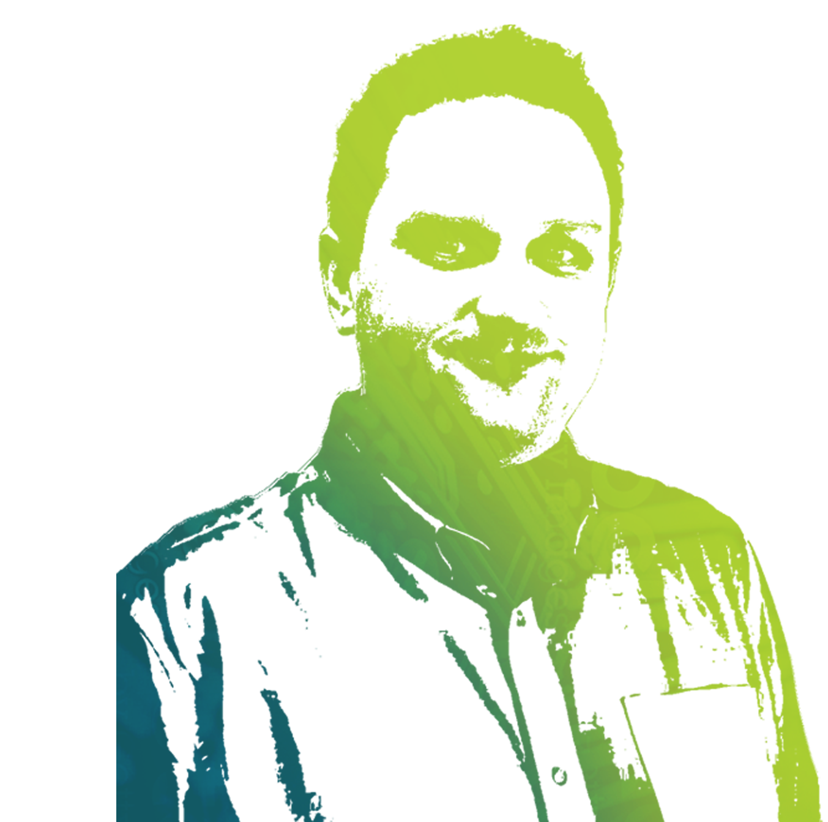
Get involved in the BCS Community
We’re a diverse community of professionals helping each other to thrive in the digital economy:
70,000
members
150
countries
41
regional branches
20
student chapters
11
international sections
52
special interest
groups
BCS Membership has helped me access a wealth of networking opportunities, across a wide range of IT professionals, and develop valuable professional relationships that have had a positive influence on my career
James Hammond MBCS

Slide 4





Benefits to support you, throughout your career
Get on track | Get knowledge | Get recognised | Get connected | Get influential
Advice, tools and support to improve your skills and accelerate your career path | Access to reports, webinars and publications to keep your knowledge and skills up to date | Globally recognised professional qualifications and standards for you and your team | Seminars and events with opportunities to network and collaborate with your peers | Thought leadership, strategic direction and growing the industry voice
CV Builder tool CV 360 evaluation 1,000+ e-learning courses Get a mentor Jobs board Member CPD Careers inspiration | ITNow magazine e-Newsletters Monthly webinars Podcasts Policy briefings Regular member surveys and reports | Industry skills framework Personal development log BCS Professional Certifications in 11 specialist areas of technology Professional registration pathways to chartered status | BCS conferences Regional branch events Special Interest Group events Community Forum Volunteering opportunities | Input to government consultations Member snap surveys Speaking opportunities Mentor programme
With BCS membership, you can find your career path, gain skills and expertise, prove your credentials, and shape the future of the IT industry.

Slide 5






Career tools to support your development
BCS tools offer the perfect blend of practical support and industry informed guidance to supplement your teaching, increasing their employability once they enter the job market.
Online
PDP
Post nominals MBCS / AMBCS
Mentoring network
£
Springboard- Career centre
Discounted training
Access to SFIAplus
I joined BCS as a professional member to increase my visibility within the community and benefit from the advice and experience of other members
Ash Camidge MBCS

Slide 6
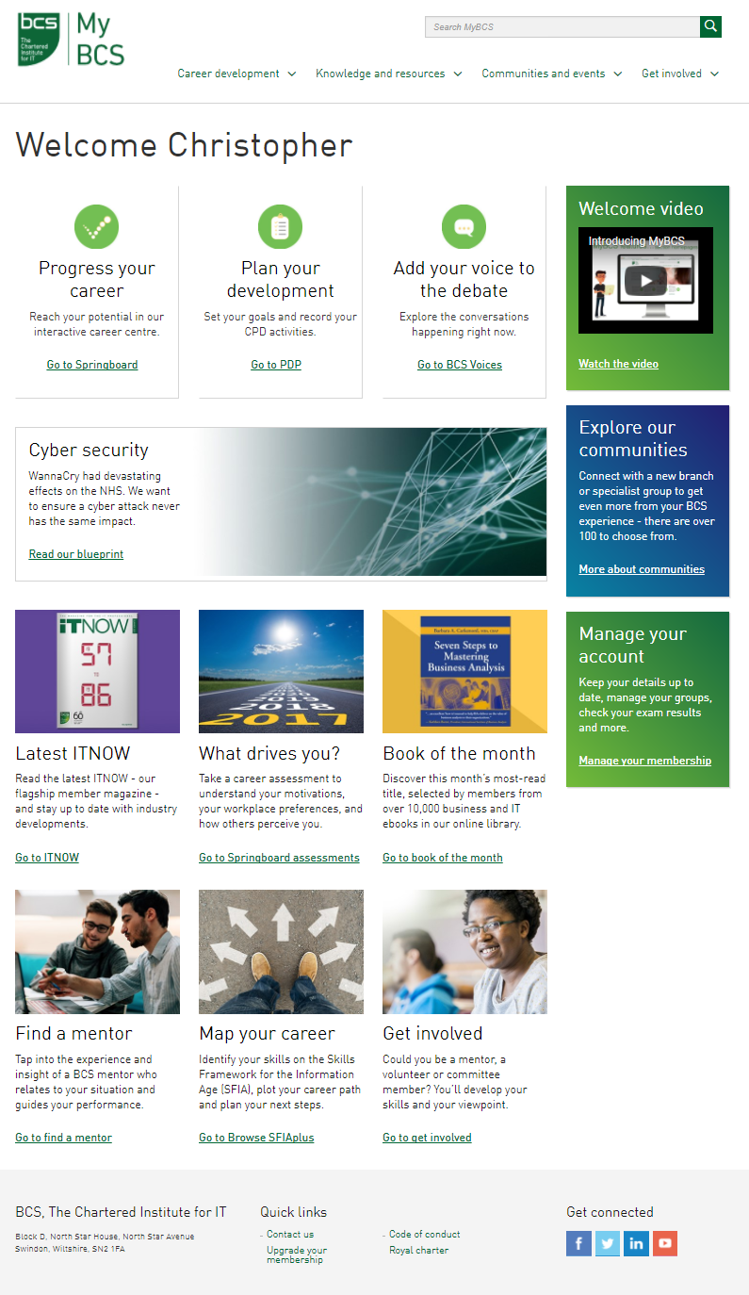
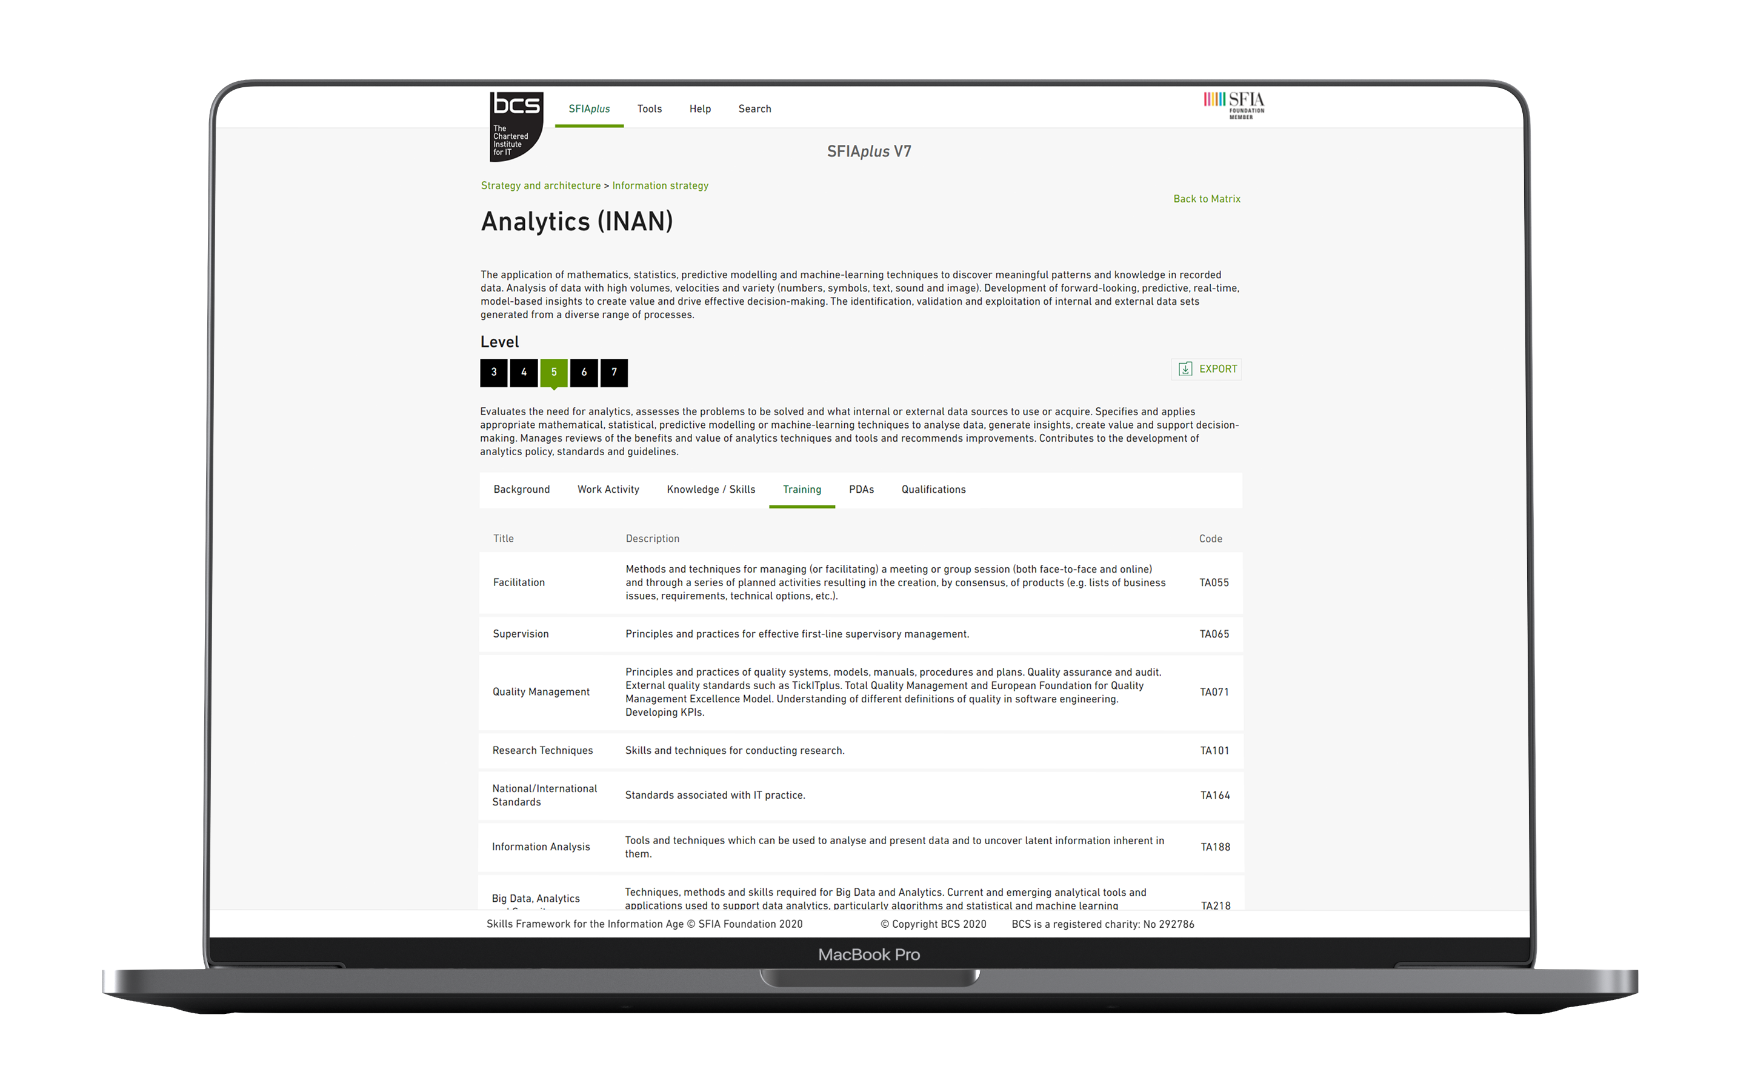
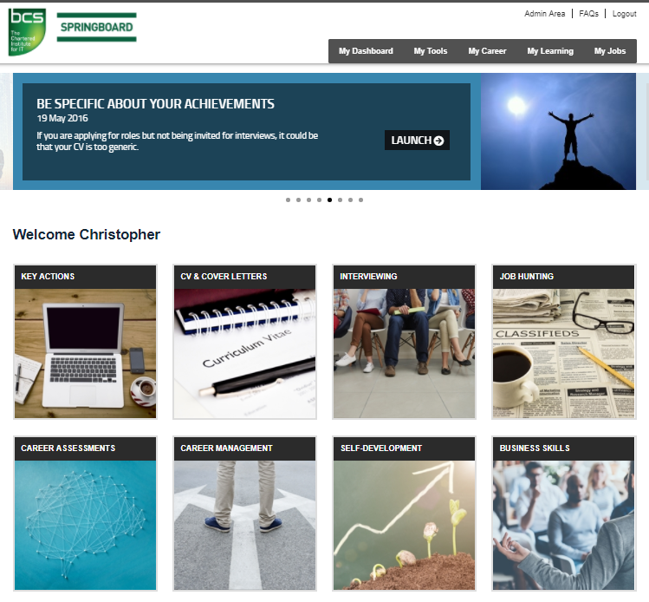
MyBCS- Member secure area
Access member only tools to support development and plot career pathways:
Bite size e-learning modules
  Business, management and technical
Personal assessments
  Aptitude personality, resilience, assertiveness & motivations
Career pathways
  Task planning tool to support career development
Interview simulator & advice
  Tips & support for going into the workplace or that next role on your journey
Browse SFIAplus
  Access to the industry standard, view associated skills and work activities for desired roles and see where your skills could take you

Slide 7

Make your commitment to CPD and professional integrity
CPD for members:
Builds the competencies that are in demand across the digital and technology profession. Available in different formats to suit learning preferences and time available.
Mapped against the SFIAplus industry framework.
Code of Conduct
Observed by every BCS member, it defines the characteristics we share as professionals serious about building a responsible computing profession. Our code comprises four key areas of professional conduct:
You make IT for everyone
Show what you know, learn what you don’t
Respect the organisation or individual you work for
Play your part in the profession, help others to do the same
Membership has provided me with access to SFIAplus, a development tool that helped me in my early career. The access to webinars and local events has been invaluable.
Jag Sohal MBCS

Slide 8



Work towards professional registrations
The RITTech standard recognises practitioners who:
have hands-on technical skills
perform a range of activities that are sometimes complex and non-routine
can demonstrate they understand the wider business context of their role
demonstrate quality and integrity in their work
Our Chartered IT Professional status can be awarded to those who can show they are:
engaged in challenging and complex activities across their organisation
in a position of influence and responsibility
committed to continuing their professional development
The FEDIP family of standards recognises informatics professionals in the health and social care sector. Standards cover a range of levels:
Practitioner
Senior Practitioner
Advanced Practitioner
Leading Practitioner

Slide 9

Let BCS help you with your next step
If you’re looking to get established…
Watch our careers inspiration webinars to understand the career paths open to you
Use CV360 to give your CV a makeover
Or hone work-ready soft skills on our e-learning platform
If you want to achieve your ambitions…
Map your skills on the SFIAplus industry framework
Get a mentor
Or check out the BCS job site
If you want to boost your credentials…
Work towards chartered status
Read a BCS book on your specialist area
Or fill a skills gap with our member CPD
If you want to build your network…
Attend BCS conferences and events
Join a special interest group
Or volunteer for a regional branch committee
If you’re looking to share your expertise…
Input to a policy survey or consultation
Speak at a BCS event
Or write an article for ITNow
RITTech gives you the opportunity to be recognised by potential employers and fellow professionals to help push your career forward.
Katy Housden, St James Place Wealth Management.

Slide 10
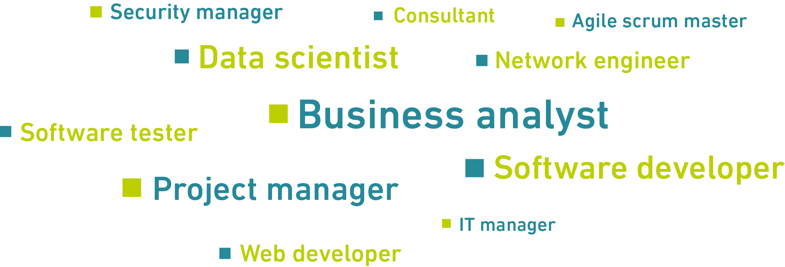
BCS is here for everyone
Let’s shape the future together.

Slide 11
Upcoming Kent Branch events
3rd October
  How “Big” Ruins “Tech”
7th November
  What On Earth To Make of CHATGPT?
5th December
  Ethics to Ensure Open Source Is Sustainable
(in Canterbury)

Slide 12
Join today!
For more information and to apply:
go to:
tinyurl.com/bcs-student-membership
Membership fees as of September 2024:
£20 for 1 year (~38p per week) or
£30 for full course (~15p per week)

