Slide 1
An Interesting Collapse
(or Why You Should Do Backups)
Bob Eager

Slide 2
What’s this about?
It’s about a rather unfortunate episode in the history of the University…
It all started back in 1830 or thereabouts…!
  someone decided to build a railway line between Canterbury and Whitstable
  this was to be the first self propelled passenger railway in the world
  to take residents of Canterbury from North Lane (near the Westgate) to Whitstable harbour, thence to catch the boat to London
the line ran across Forty Acres Road, and under the future site of the University
tunnel entrances in the grounds of the Archbishop’s School, and behind Giles Lane car park
the line worked well, but closed in 1952

Slide 3
the University authorities were aware of the tunnel, but were assured it was stable
but in July 1974 it became very unstable!
...and bad things started to happen....

Slide 4
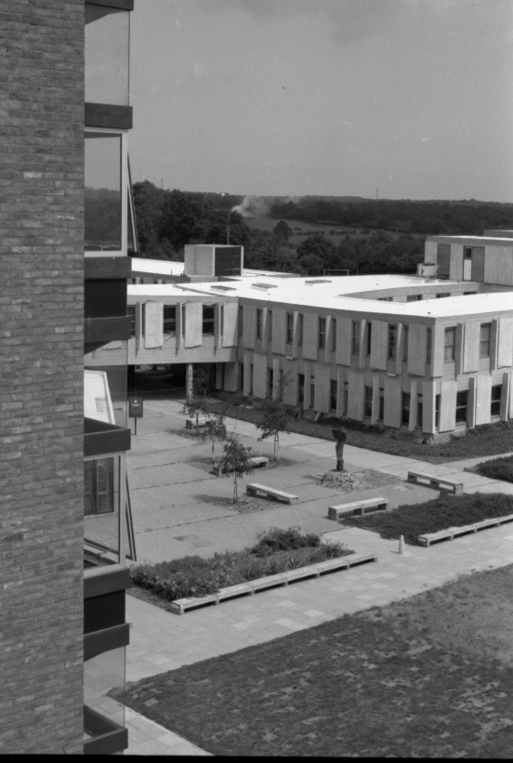

Slide 5
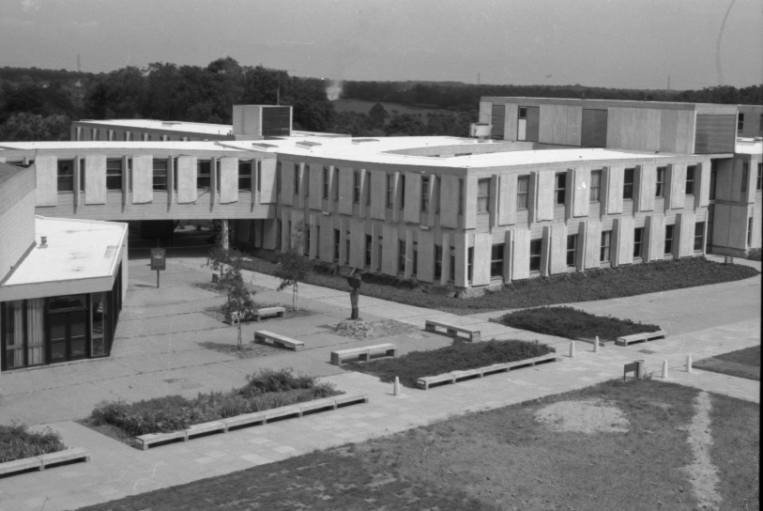

Slide 6
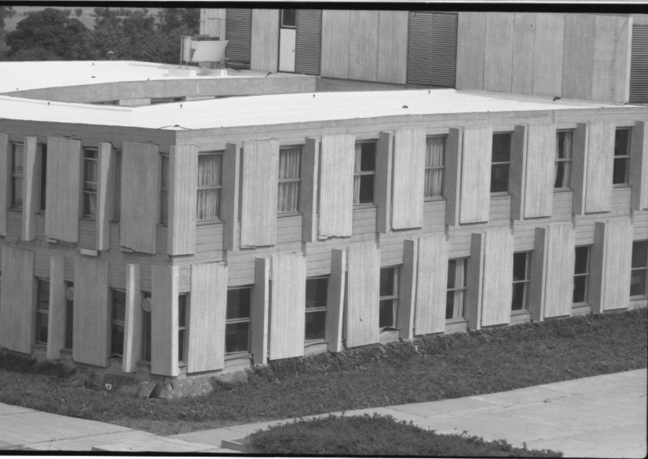

Slide 7
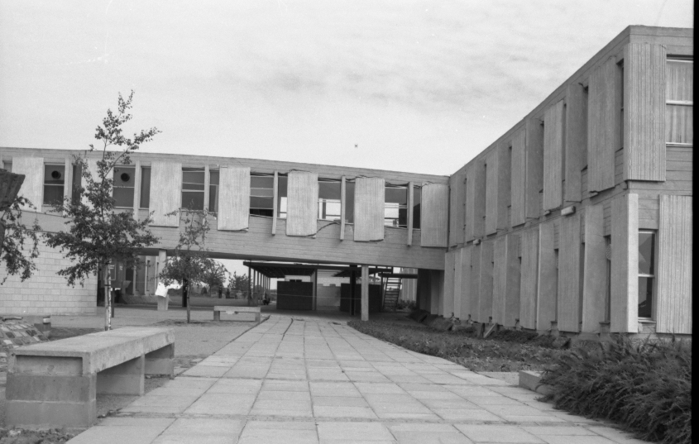

Slide 8
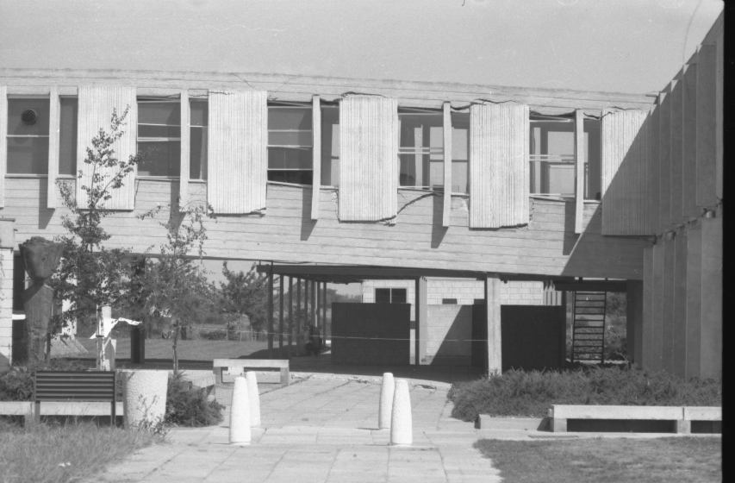

Slide 9
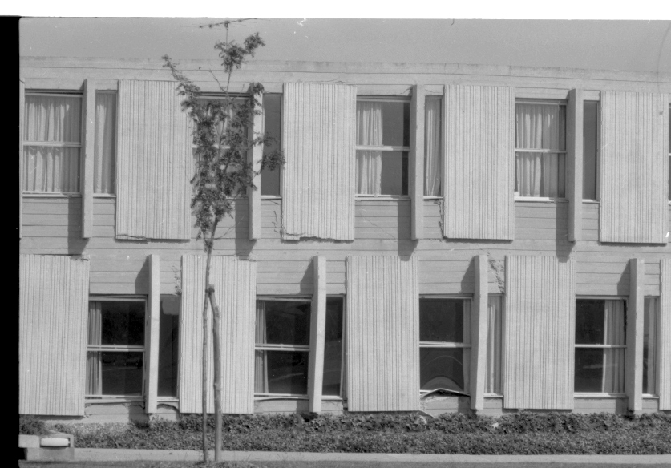

Slide 10
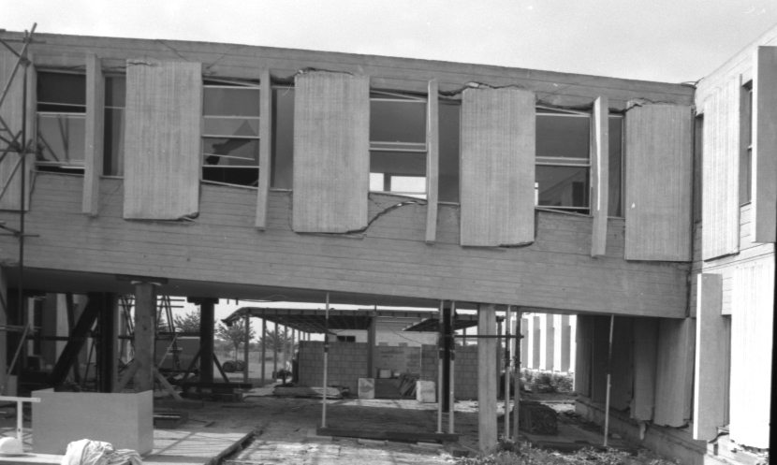

Slide 11
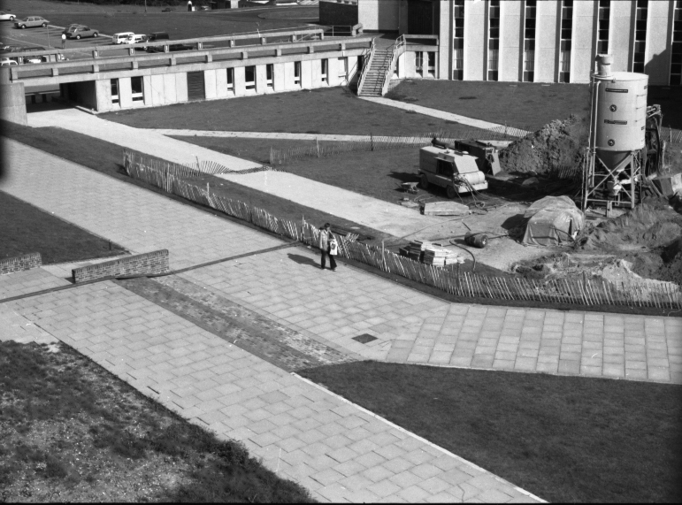

Slide 12
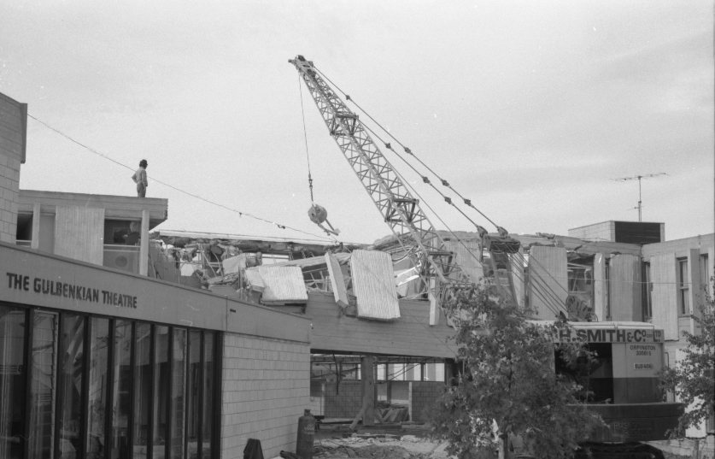

Slide 13
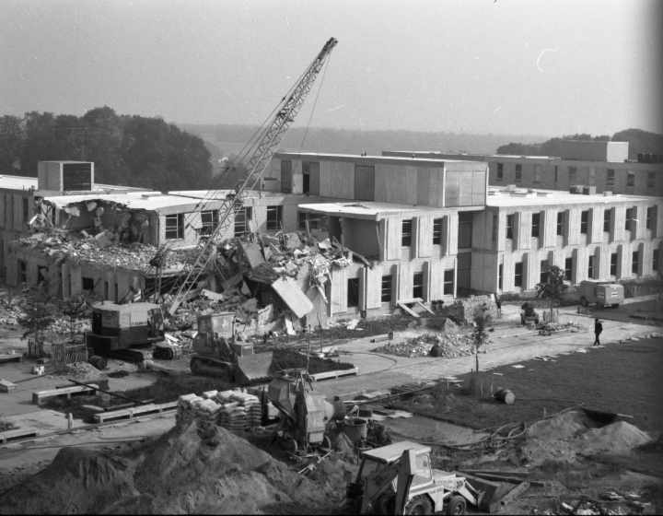

Slide 14
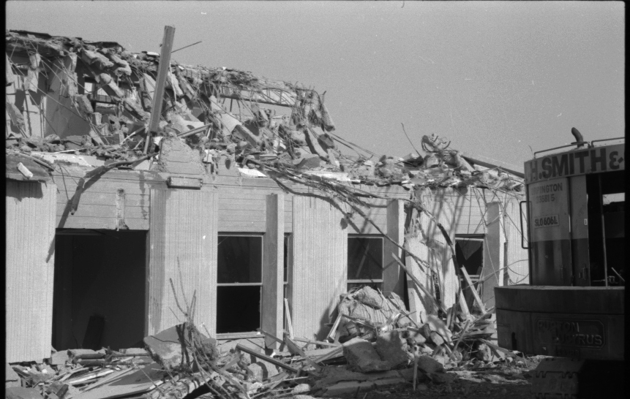

Slide 15
