Slide 1
Messages from the Future
or “Things you will have wished you’d known”
Bob Eager
September 2024

Slide 2
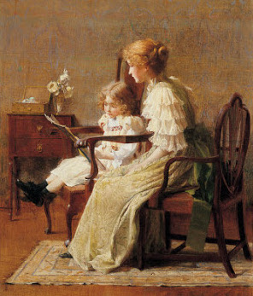
Introduction
From “The Hitch-Hiker’s Guide to the Galaxy”:
  Arthur Dent: You know, it's at times like this, when I’m stuck in a Vogon airlock with a man from Betelgeuse, about to die of asphyxiation in deep space, that I really wish I’d listened to what my mother told me when I was young.
    Ford Prefect: Why? What did she tell you?
    Arthur Dent: I don’t know! I didn’t listen!
So now is the time to listen …
  Some of this is stuff picked up over the years
  Some of it was crowdsourced from other students and graduates, on Bob’s own Facebook group which contains some students from over 45 years ago, and some who graduated much more recently!
Use what works for you…but try some new stuff while you’re here

Slide 3


Networking
No, not computer networking…that starts later…
Friends – real friends, not the hundreds you have on social media, etc. - this is where you start making them
“A good friend will help you move; a great friend will help you move a body”
and “really great friends will bring a spade and not ask any questions”
You’ll help each other for many years to come

Slide 4

Engaging with people
Get to know important people, as a long term thing
  not just at university, but at work and everywhere
  secretaries, cleaners, building managers, postmen, delivery people, catering staff
  make their life more interesting, and yours will be too
Use common rooms, bars and other meeting places
  look at “Fermat’s Last Theorem” and the use of a common room
  Google’s management of restaurant queues
Meetings are important, but going to the pub afterwards is often the best bit; non-alcoholic is fine

Slide 5
COVID may not have been all bad
It developed skill in remote working
Who knows what will happen this (academic) year?
Hang on to your skill in online meetings
You can use Teams (if licensed), Zoom, and other offerings
… and of course there are many other electronic forms of communication, such as group chat, Discord, etc.

Slide 6
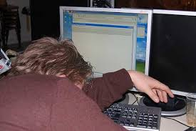
Try New Stuff
University is one of the cheapest, easiest places to try new stuff
  Sports
  Societies
    Ballroom dancing? K-Pop dance?
    Debating? Sign language? Frisbee?
    Probably TinkerSoc!!
  Don’t forget all the other stuff – take a break from computing too
Don’t live in your room all the time
Travel round Kent – it’s a nice place

Slide 7
Immerse yourself
University isn’t a part time occupation
  don’t turn up for a lecture and then just go home/back to your room; this is really important
  talk to people!
This isn’t school or college – you have to live it to get the most out of it (and get a good degree)
Meetings aren’t just for content – they’re for what happens before and after
  part of the ‘living’ is places like the Hackspace
Pubs and cafés are important places, as are common rooms
You learn from your peers as well as from staff
Staff learn from you!

Slide 8
Academic stuff
everyone has their own approach; plenty of study help available
start coursework when you get it, or you will get terribly behind
  embarrassing when you start it on the last day and something is missing
don’t disregard things you think you’ll “never use”
don’t trust the system – check
don’t assume lecturers are always right!
don’t assume books are always right!
never assume the Internet is right!
BIG lesson
  NEVER be afraid to ask
  you’ll look silly if you bluff and fail
  mistakes are fine – that’s how you learn

Slide 9
Odd advice
look after yourself!
  try to eat properly (no one else around to make sure you do)
  go for a walk somewhere instead of arguing on social media!
trust yourself! You may well be right, and everyone else wrong – but don’t count on it
it’s more important to be yourself than to be accepted
  do what you want (as long as it’s legal …)
  this might be your first chance
be curious, all the time
  not just computing, but everything
  learn something new every day

Slide 10
More odd advice
join LinkedIN now and start building connections
  a good job marketplace, and useful in second year
sanitise your social media history while you still have time!
just have fun
  be creative
  try new things, get involved, EXPLORE!
  if interested, get into an open source project
make yourself stand out – now is a good time if you want to re-invent yourself a bit
sort out your study space to make it easy to study

Slide 11
Finally
you’re here to work, but to have fun too
don’t live in a straight line – take the scenic route
personal development is really important, and really part of your degree
get out there and
LIVE IT!
http://messages.bobeager.uk

