Slide 1
Resurrecting Old Systems For
Fun (and Profit?)
Bob Eager CEng FBCS CITP MIET
BCS Kent Branch
Open Source Specialist Group
12th June 2025
http://emulation.bobeager.uk

Slide 2
Bob Eager
  Graduated in Electronics from University of Kent in 1973
  M.Sc. In Computer Studies at Essex in 1973-74
  Research student at Kent 1974-78
  Part time programmer at Kent 1976-78
    Wrote a number of compilers on various systems
  Lecturer/senior lecturer in Computer Science at University of Kent, 1978-2015, specialising in compilers and operating systems
  Managed or co-managed a number of different Kent systems between 1974 and 2015, including:
    Elliott 4130
    ICL 2900 (VME/K, then EMAS)
    Digital VAXcluster
5

Slide 3
What Is Emulation?
In the context of computing, it is the use of one or more computers to ‘pretend’ to be another computer
This can be at a number of different levels, depending on requirements
The aim is for the emulated system (or partial system) to be indistinguishable from the ‘real’ system
  At the user level
  At the program execution level
  At the programming level
There may not even be a ‘real’ system (e.g. in an educational context)

Slide 4
Why Use Emulation?
There is more than one answer …
  For fun; emulating a computer that you don’t have, so that you can play with one anyway
    Just for interest
    To play games for nostalgic reasons
  For education; to learn about how a particular computer works
    This could include a machine that is too expensive or critical to play with ‘live’
    For training purposes
  For development purposes, exploiting possibly better debugging aids in the emulated machine
    A good example is the development of mobile phone applications
  For selective replacement of hardware by software
  For migration from legacy systems
4

Slide 5
More answers:
  For software development before the real hardware has been developed
  For testing out new ideas and planned architectures
  For regulatory purposes; an emulator can be certified to be ‘equivalent’ to the emulated machine, allowing older (certified) software to be run
  For commercial purposes; an older architecture can be emulated to achieve backward compatibility
    This might be partial or complete
    For example, some 50-year-old code still exists in a modern system, although the hardware is long gone, and it is run on an emulation of the original CPU
  Playing old games
Is speed an issue?
  Generally, not in terms of slowness
  Advances in hardware have been so rapid that there is more likely to be a problem with the emulator being too fast
1

Slide 6
Levels Of Emulation
Emulation can be complete, or partial
  It covers a wide spectrum, depending on the application
Because emulation is a complex business (often more complex than is realised), it is wise to research what exactly is needed
Sometimes it is not needed at all; a simple duplication of an API may be sufficient
We will examine some possible levels in the examples, but in practice it is a spectrum
There are often both closed source and open-source solutions

Slide 7
Complete Emulation
Complete emulation of a computer system, particularly an older one
  CPU (instruction set, etc.)
  Memory and memory management
  Peripheral subsystem (e.g., autonomous data transfer)
  Peripheral controllers (e.g., disk bank, tape cluster)
  Individual peripherals (e.g. disk, tape, console, printer, card reader)
This requires the construction of a computer program that can:
  Provide emulated memory (e.g. as an array)
  Emulate paging and/or segmentation (or similar), including TLBs etc.
  Fetch instructions, decode them, and execute the documented action
  Handle instructions that perform control and I/O functions, and forward I/O to emulated peripherals (which are also needed)
  Simulate interrupts as and when required (including clock)
  Provide methods to control and replicate timing in the real machine
1

Slide 8
CPU Emulation
Partial emulation of a computer system, omitting parts that are done in some other way
Emulation would probably include:
  CPU (instruction set, etc.)
  Memory and (perhaps) memory management
  Some way to introduce data, and to read it out
    This could be as simple as switches and lights
    Another way might be to provide a single limited peripheral (e.g., a linear stream of data, akin to paper tape reader and punch)
This requires the construction of a computer program that can:
  Provide emulated memory (e.g. as an array)
  Fetch instructions, decode them, and execute the documented action
  Handle a limited peripheral if desired
1

Slide 9
Emulation Layer
Emulation of the instruction set, with some memory
This might be because there is legacy code that cannot easily be rewritten, and that code can be made to sit on top of a newer system
  That has been done with 50-year-old code, in a commercial context
This requires the construction of a computer program that can:
  Provide emulated memory (e.g. as an array), probably a lot smaller than the memory in use by the modern software
  Fetch instructions, decode them, and execute the documented action
  No peripheral interaction necessary except via defined APIs
1

Slide 10
Selective Instruction Emulation
It was once common for computer manufacturers to produce machines at several price points
  Top of the range machines did everything in hardware
  Cheaper machines emulated ‘complicated’ instructions in software by having the hardware force an interrupt for an unsupported instruction, and having the operating system emulate it
    Floating point arithmetic
    Decimal arithmetic
    Very complex instructions
  The Digital VAX systems had a complex instruction called POLY (evaluate polynomial!) and there was little consistency in how it was implemented in hardware, microcode or software
    Eventually, it was always emulated, even when hardware existed, in the name of consistency
1

Slide 11
Emulation examples
A few are closed source, and often not free:
  WinEight (PDP-8)
  Charon (PDP-11)
Open-source:
  SIMH
  PCjs
  Hercules
  DOSBox
  And many more
Also see the extensive set of emulators for earlier machines:
  https://www.computerconservationsociety.org/emu/index.htm
2

Slide 12
Example – Hercules
Hercules is an open-source software implementation of the IBM mainframe System/370 and ESA/390 architectures
  In addition, it supports the 64-bit z/Architecture.
Hercules runs under Linux, Windows, Solaris, FreeBSD, and MacOS
More can be found at:
  http://www.hercules-390.org/
This is a full emulation, and it also supports:
  3270 terminals
  Console
  Printers
  Card reader and card punch
  Disks
  Tapes
  … and more
1

Slide 13
Example – SIMH
SIMH is a well known and popular suite of open-source emulators
It was originally developed by Bob Supnik, a DEC engineer and vice president, and most of the emulators are for DEC systems; however, other systems are also supported
Emulations include:
  PDP-{1,4,7,8,9,10,11,15}
  VAX-11/780, VAX 3900
  IBM {1401,1620,7090/7094}, IBM System 3
  HP {2114,2115,2116,2100,21MX,1000,3000}
  Interdata (Perkin-Elmer) 16bit and 32bit systems
  Honeywell {H316,H516}
‘Classic’ SIMH is the version still supported by Bob Supnik, but there are forks which are more advanced, but have a chequered history
1

Slide 14
The SIMH suite also includes tools for:
  Data manipulation (e.g. creating emulated magnetic tapes)
  Cross assembling
  Access to emulated disks
  etc.
SIMH also provides many software kits for use on the emulators; these include manufacturers’ systems and others, for example:
  UNIX Sixth Edition (circa 1975) for the PDP-11
  BSD UNIX for the VAX
  Mini-UNIX (nothing to do with Minix)
  TSS/8 (a timesharing system for a 12-bit 32k PDP-8)
  Autocoder and FORTRAN for the IBM 1401
Probably most importantly, the SIMH source (in C) is a framework for writing new emulators, which makes it relatively easy to do so
2

Slide 15
Hardware Refinements
Enthusiasts have chosen to enhance emulators by constructing hardware ‘front ends’, or ‘front panels’, for a more authentic experience
Typically, the emulator is hosted on a Raspberry Pi which is incorporated into the panel, providing network connectivity and more
The most well-known hardware enhancements can be found at the Obsolescence Guaranteed website:
  https://obsolescence.wixsite.com/obsolescence
These take the form of simple kits, although they can sometimes be purchased pre-built (add your own Raspberry Pi), for example:
  PiDP-8
  PiDP-10
  PiDP-11
  PiDP-1 (soon)
These are open-source hardware and software
Anyone who has used the original systems will find them very familiar

Slide 16
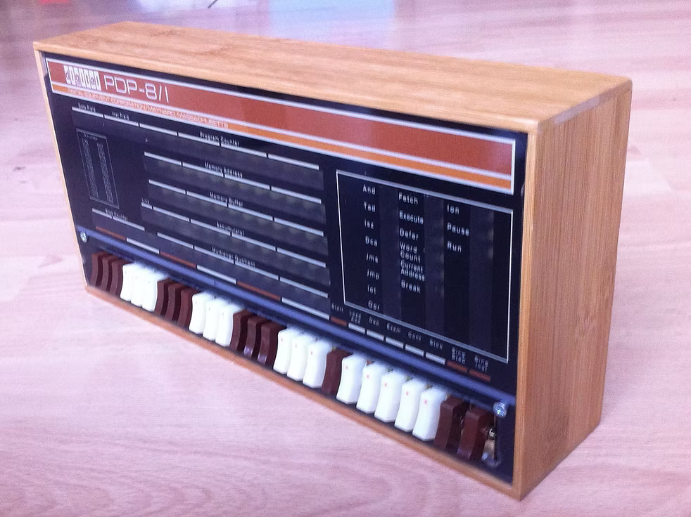
PiDP-8

Slide 17
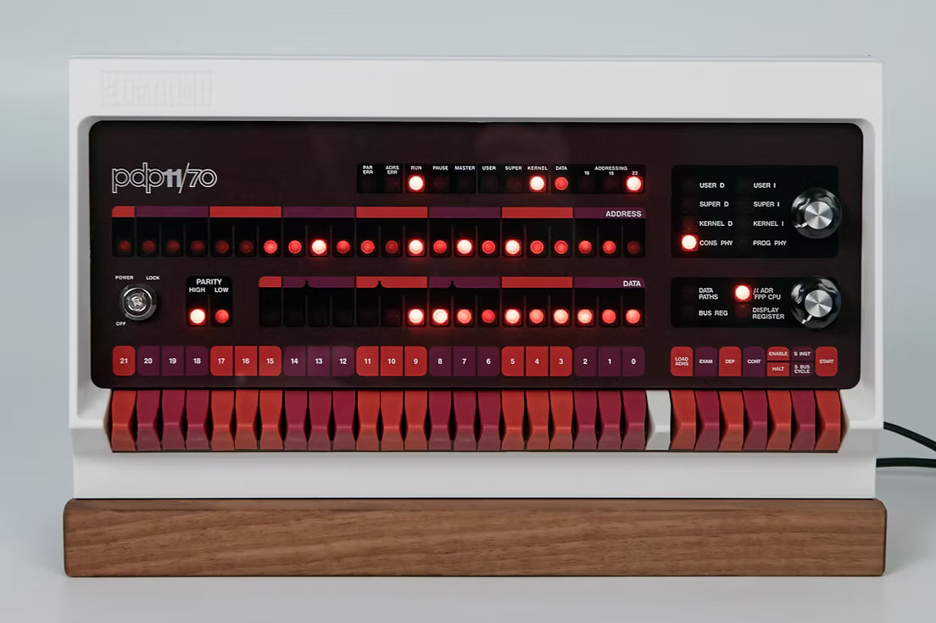
PiDP-11

Slide 18
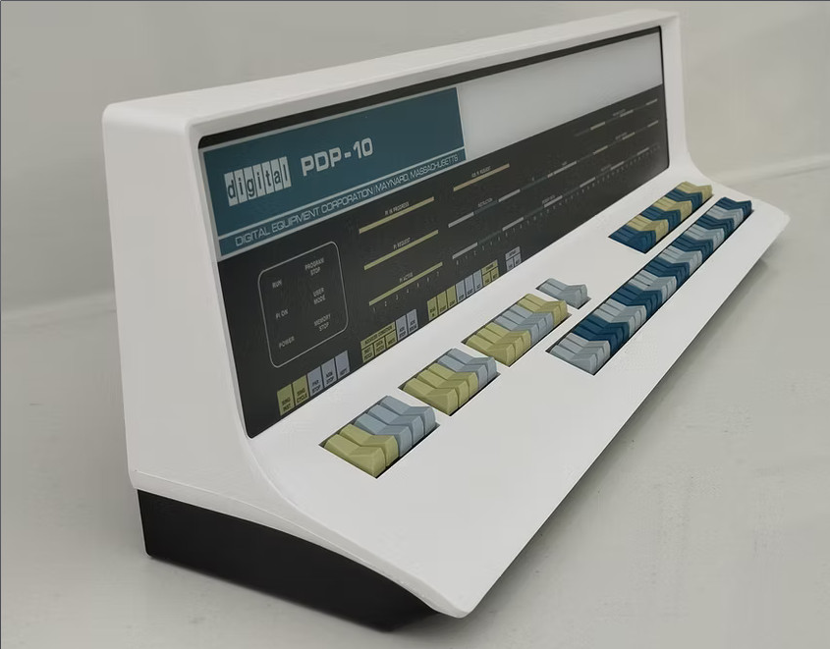
PiDP-10

Slide 19
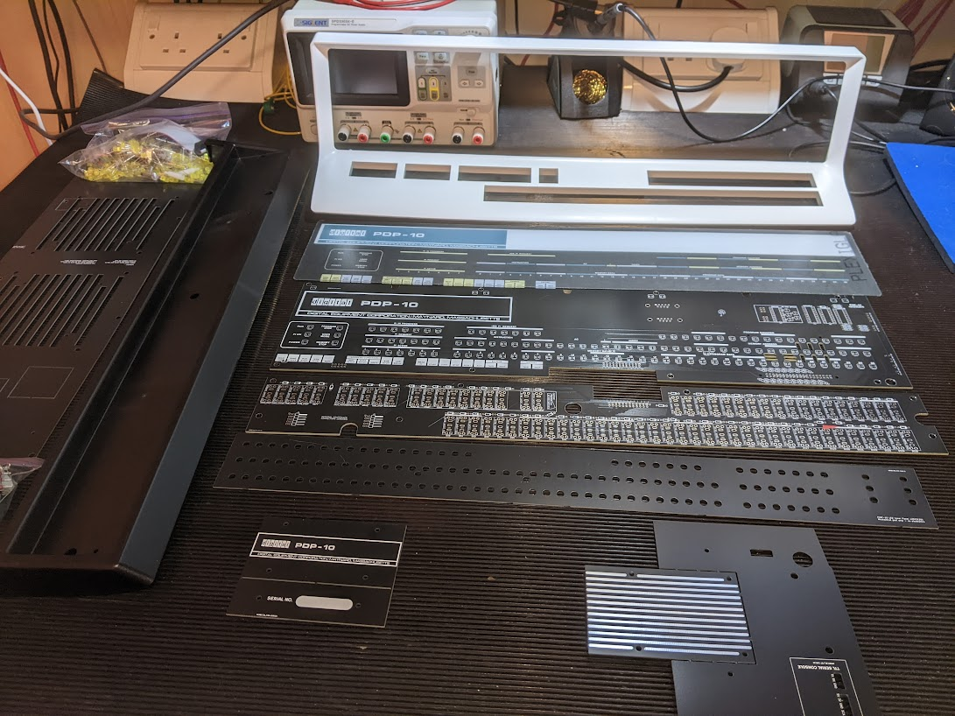
The PiDP-10 kit

Slide 20
Implementation
A simple example: the PDP-8
12-bit word (no bytes!), 32k words, one register (AC), program counter (PC), and Link (1 bit); also MQ (optional) as extended AC
Some internal registers for memory management
8 basic opcodes
  TAD, DCA, ISZ, AND, JMP, JSR (conventional instructions)
  IOT (input-output)
  OPR (‘operate’, address field encodes instructions)
    Conditional skips, shifts, simple AC changes
See Wikipedia for more details:
https://en.wikipedia.org/wiki/PDP-8

Slide 21
To emulate the PDP-8, the basic data structures are
  An array of 32,768 cells, at least 12 bits in width
  Cells (variables) for AC, link, PC, MQ, internal registers
  A Boolean flag, set when an interrupt condition occurs
A basic user interface for setting/examining values in the above
The emulation itself:
  halting = false
  do until halting
  extract instruction from memory array at index PC
  decode opcode
  fetch operand from memory if required
  execute instruction; if HLT, set halting to true
  if instruction did not update PC, increment PC
  end

Slide 22
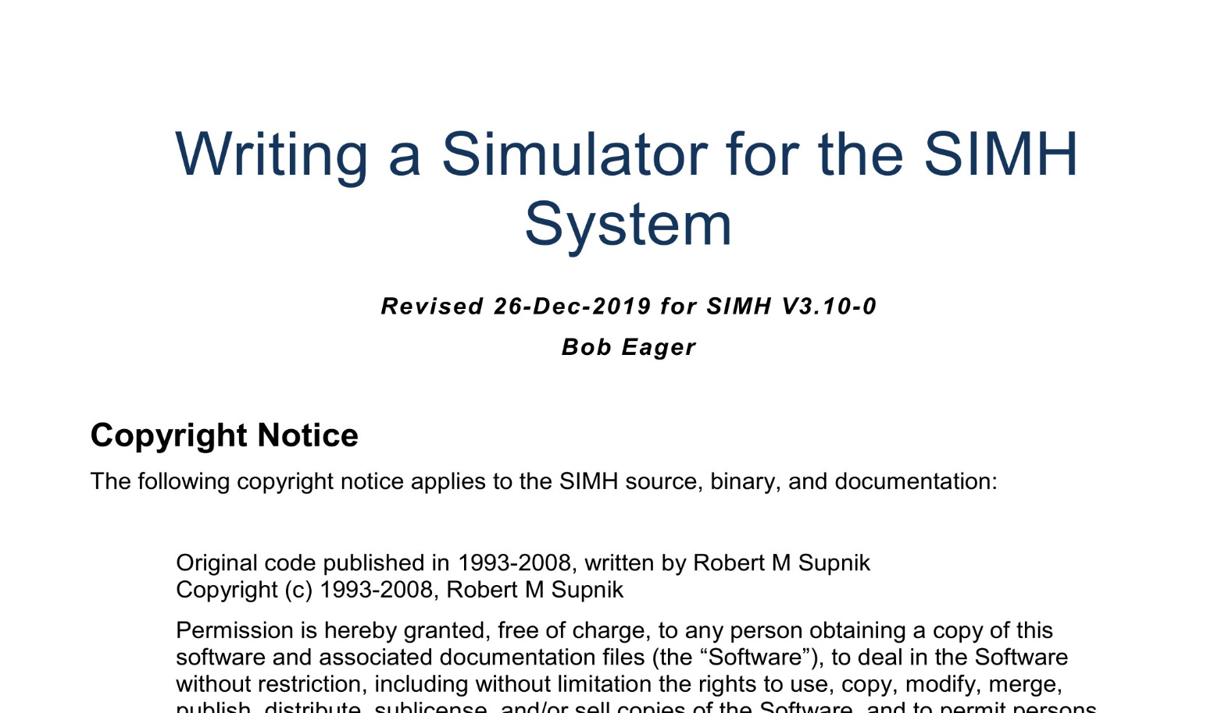
Using SIMH to write an emulator
SIMH provides a complete framework for writing an emulator
It is well documented!

Slide 23
Preparation
  Decide on mapping of data types (may need 64-bit variables)
    Words per instruction, integer size, default number base, etc.
  Decide on devices; build a table of device structures
    Memory, CPU, keyboard, display, disks, tapes (these are all considered devices)
    There may be multiple instances of some devices, and even multiple controllers
  Provide a binary loader/dumper function
  Provide functions for parsing and printing symbolic instructions (yes, a mini assembler!)
  Provide functions to emulate peripherals, and hook them into the device table
  Optionally:
    Provide functions for parsing and printing addresses
    Provide an extension table for additional user interface commands
    Provide a command input function
1

Slide 24
  Decide on how to provide an execution time base, which could be:
    Microseconds (or whatever) of real time
    A simple instruction count (by far the easiest)
  Provide a way of organising interrupts
    A simple method is a flag that is set by a peripheral (or other interrupt source); this is checked after each instruction is emulated
  Lastly (of course) is a loop which fetches and executes instructions; the implementor must provide this
  SIMH has a control module (SCP) which initializes all devices (via the device table); it asks for user commands, then on demand will enter the execution loop
  The execution loop terminates on a halt instruction or other relevant event

Slide 25
Emulation of devices (including some pseudo devices) is driven by calls via the device table
  One consideration is ‘real world’ timing; if the device responds too quickly, the operating system may crash (race conditions, sanity checks, etc.)
  Devices (e.g. disks) may be linked to files as part of the emulation; association of devices with files will form part of the command interface
  SIMH provides some help here for devices such as serial ports, network interfaces, and magnetic tapes
Clocks can also be an issue
  Internal clocks are usually linked to the time base, and easily implemented
  Real time clocks can be linked to the actual host clock
Idling can be a problem; when the simulated CPU is idling, it will often consume significant host resources
  Suffice it to say that this can be worked around if the host provides nanosleep facilities
1

Slide 26
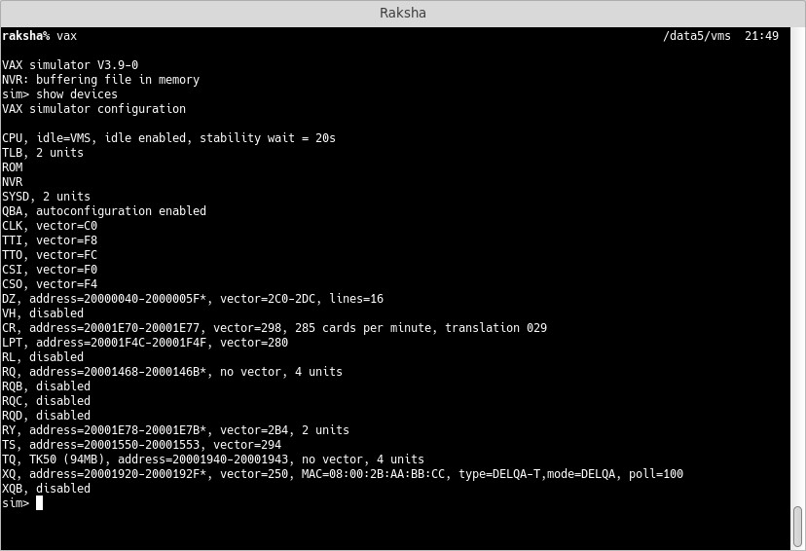
Sample simulation of a VAX, and VAX/VMS

Slide 27
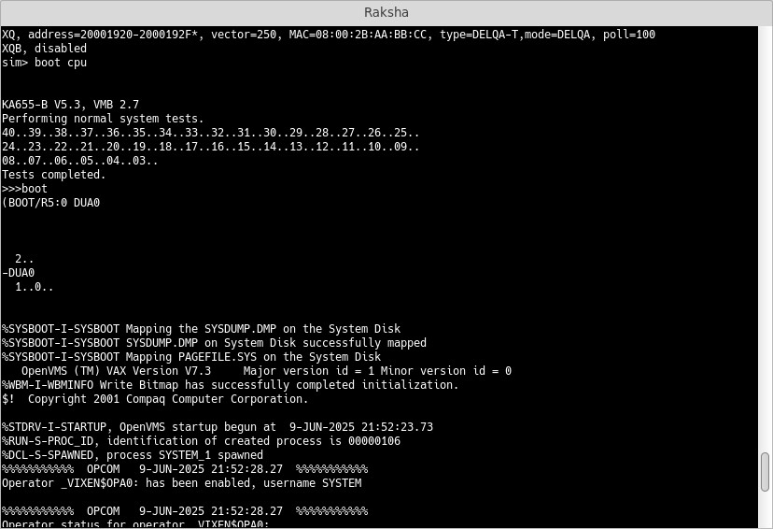

Slide 28
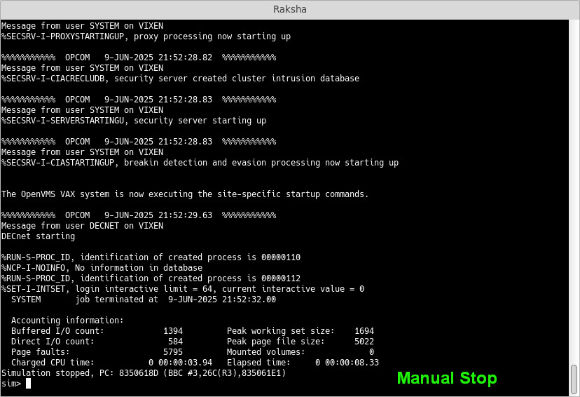

Slide 29
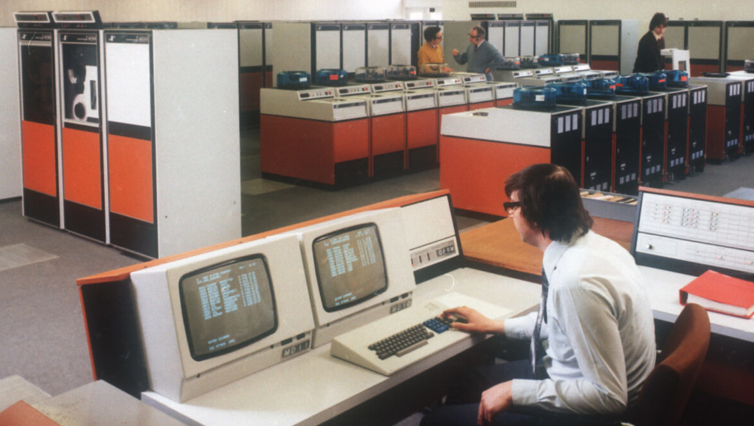
Current Work
Hercules is still being developed, keeping up with IBM hardware development
Emulation of the x86 architecture continues to develop, both commercially and otherwise
Bob continues to work on an open-source emulation of the original ICL New Range systems (2900 P series)
© David Marsh

Slide 30
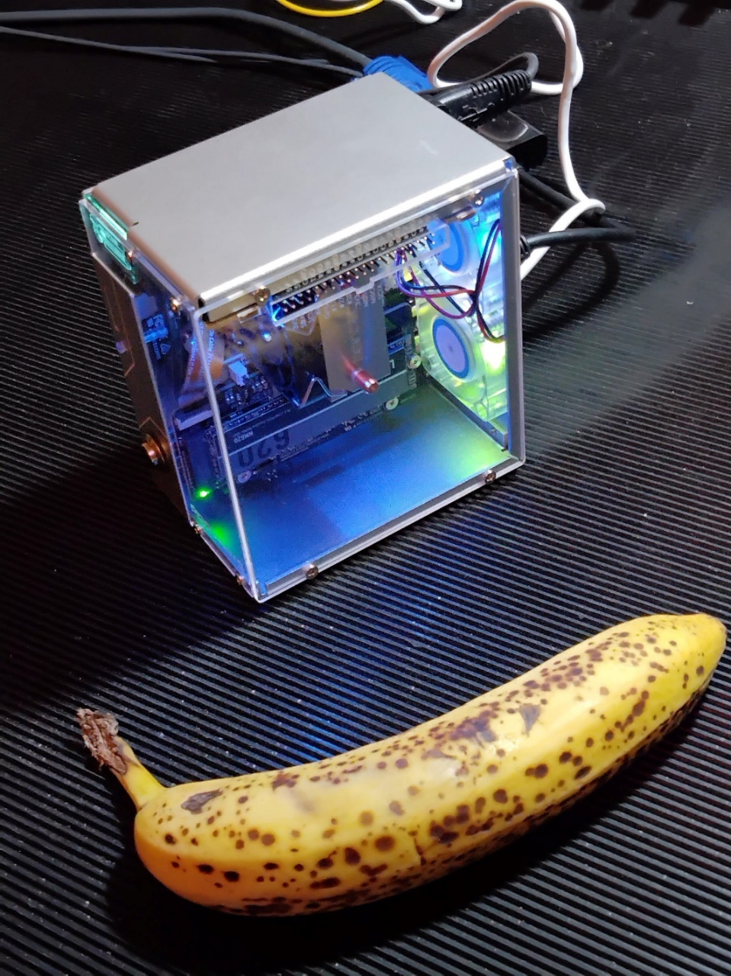
Pironman 5
The PDP-10 and 2900 emulators will run on this, as a ‘mainframe in your pocket’ (as will all the others)
Pironman5 is a Raspberry Pi 5 enclosure which provides excellent cooling, as well as some pretty lights and even a programmable text display.
It is a good vehicle for a very portable emulator! It comes as a ‘kit’; add your own Raspberry Pi 5.
This one is an 8GB model, which is more than adequate.
See Amazon, Elektor, and other suppliers

Slide 31
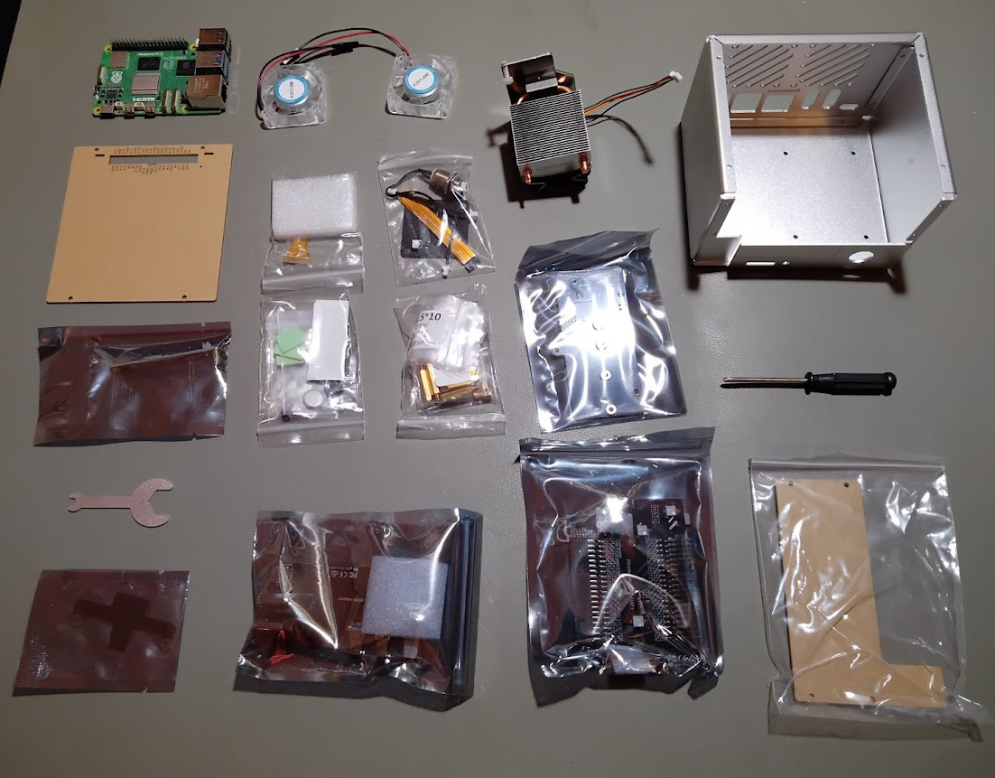
Pironman5 Kit

Slide 32
Conclusion
  Playing with old computers is instructive, and fun!
    Real old computers are hard to obtain, and expensive
  Emulation can be done entirely with software
    SIMH runs on Windows, MacOS, Linux, BSD …
  Emulation with display hardware is nice, but involves some financial outlay
  Writing your own emulator is both instructive and fun (FSVO fun)

Slide 33
Questions?
http://emulation.bobeager.uk

Slide 34
Contact and further details
Contact Bob at:
  bob@eager.cx
Bob’s emulation website
  http://emulation.bobeager.uk
  Includes references and acknowledgements
X

