Slide 1
A University On The Move
Bob Eager
Former Staff Association Lecture
21st May 2025
http://ukcmove.bobeager.uk

Slide 2
Bob Eager and this lecture
  Arrived at Kent in 1970, reading Electronics
  Subsequently postgraduate, support staff, academic staff, Master of Darwin College
  Taught by at least one person here today, and worked with others
  Lived on campus for six years, and have seen it grow
  Explored most of the University site (sometimes legally)
  Retired in 2015, now on FSA Liaison Committee
  There turned out to be too much to cover in the time, so this is mainly limited to the first 15 years
  References abound, so see the website:
  http://ukcmove.bobeager.uk
1

Slide 3
Overview
Why On The Move?
  People joked about travelling to Canterbury on a passing College
  This is about the University’s move forward
This is mainly (but not exclusively) about the University site
  Not about politics (internal or external)
  Not about academia
There will also be a few snippets and anecdotes:
  “Merely corroborative detail, intended to give artistic verisimilitude to an otherwise bald and unconvincing narrative”
This is not a complete history, but should throw a light (and some new pictures) on little-seen aspects
Sources: Self, friends, colleagues, books, documents, even the Internet
2

Slide 4
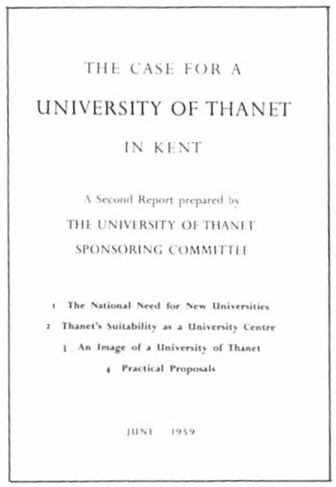
The Choice of Site
A university in Kent had been suggested for a very long time, but this gained impetus in the late 1950s
One reason was the impending 18 year olds from the ‘baby boom’
There was a preference for somewhere central or easterly, as a clear separation from London, if possible with cultural significance
  Note that the University of Sussex is about as far away from London as possible, despite the reputation of Brighton as “…a town that always looks as if it is helping the police with their inquiries”
Bids were put in by many places, inter alia Ashford, Dover, Folkestone, Maidstone, Margate (Manston) and Ramsgate (Ramsgate airport)
2

Slide 5
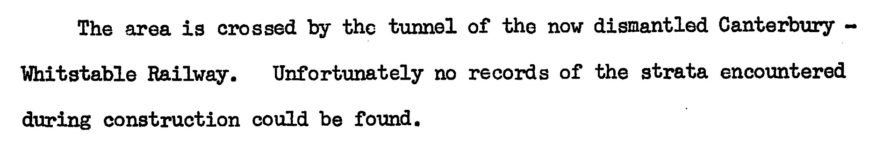
The Final Site
  Canterbury had been proposed as far back as 1947
  An historic site (although, arguably, so is Thanet)
  Approximately 300 acres at the time (about 2½ times the area of Vatican City)
  In 1962, Ove Arup and Partners were commissioned to undertake an initial investigation of the site
  The name ‘University of Canterbury’ was not popular, least of all in New Zealand, or indeed in the county
  Lord Holford was early architect
  “Don’t mention the tunnel!”
  “I mentioned the tunnel once, but I think I got away with it”
1

Slide 6
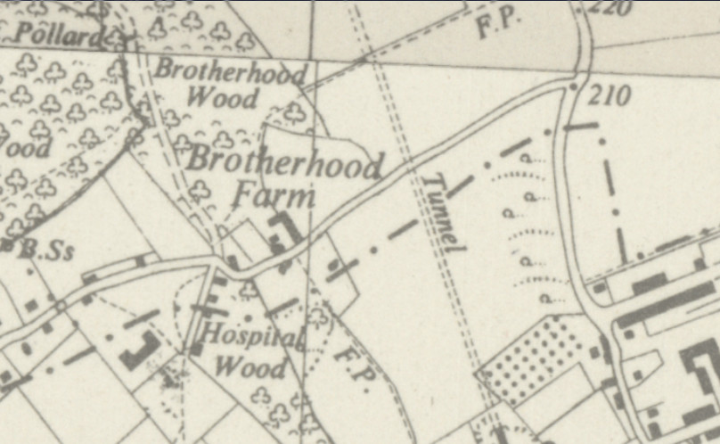
The site was divided roughly east-west by the original line of Giles Lane
  from Whitstable Road to the eventual site of Keynes College, as it is now
  From there to Hackington Road, along the line of the part in front of Eliot and Rutherford
The eastern portion of Giles Lane was realigned with an existing footpath

Slide 7
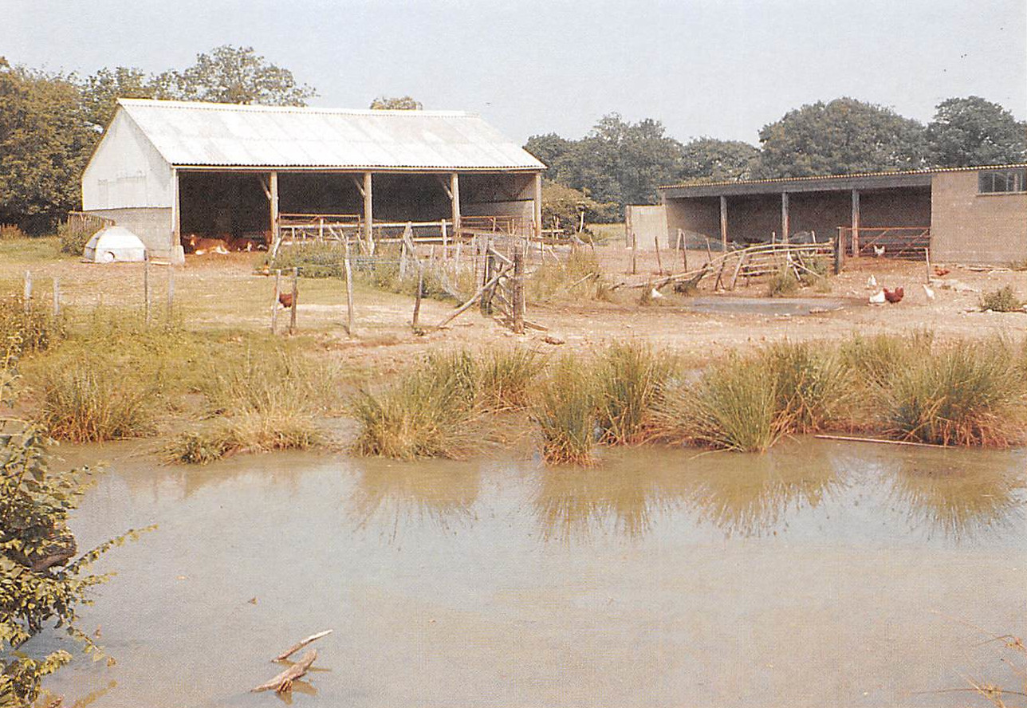
Brotherhood Farm was part of the compulsory purchase, here viewed from a point roughly at the end of Eliot causeway today

Slide 8
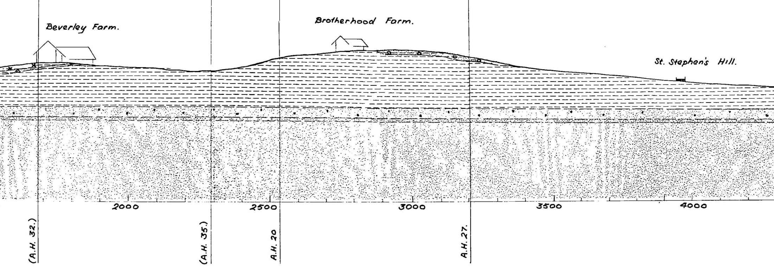
Suitability of land
  Plateau at top of slope fairly flat
  Ridges and hollows on slope difficult to fix without affecting stability
  Good flat area at bottom for sports, even a stadium, etc.
    Compulsory purchase of this portion out-manoeuvred by the landowners
    Substitute land used, owned by St John’s Hospital (near Keynes site) and Eastbridge Hospital (including the Hothe Court area to the north- east)
(vertical scale exaggerated by a factor of 5)
East-west cross section
1

Slide 9
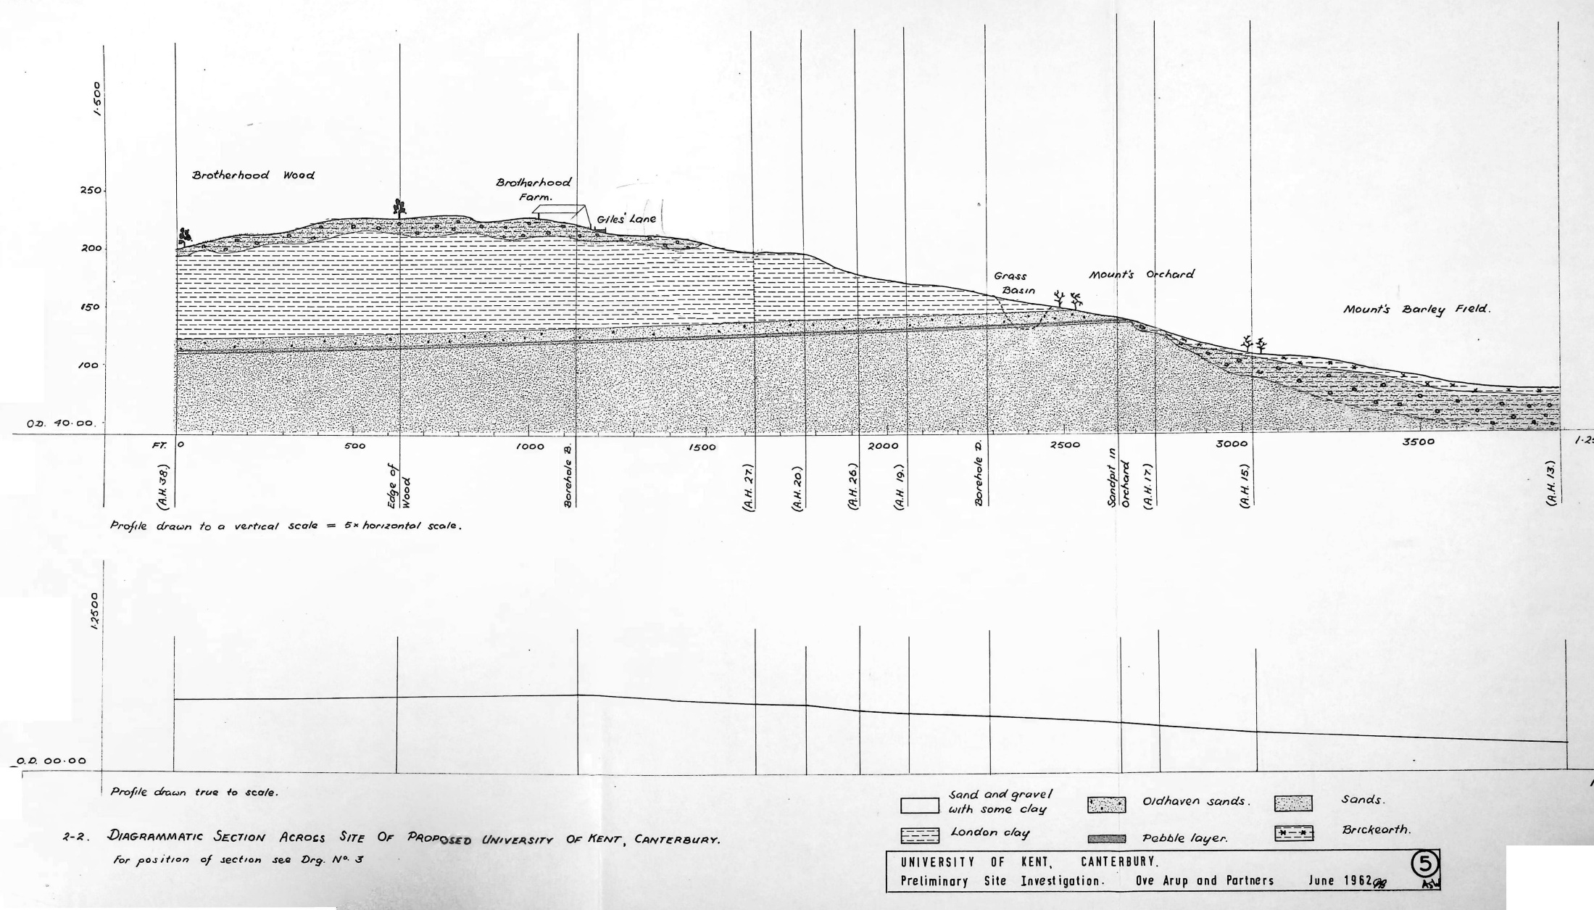
North-south cross section

Slide 10
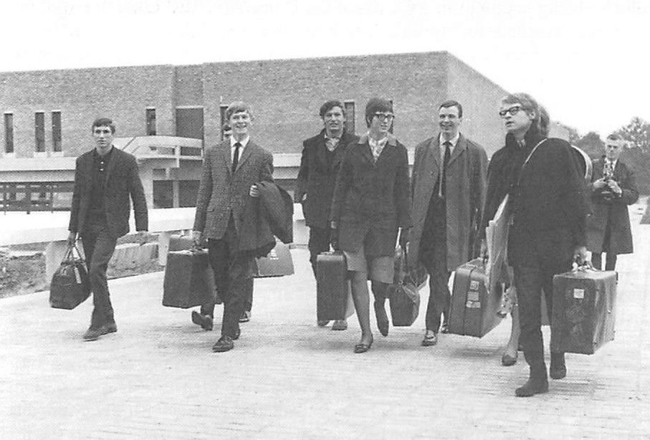
Early Days
1

Slide 11

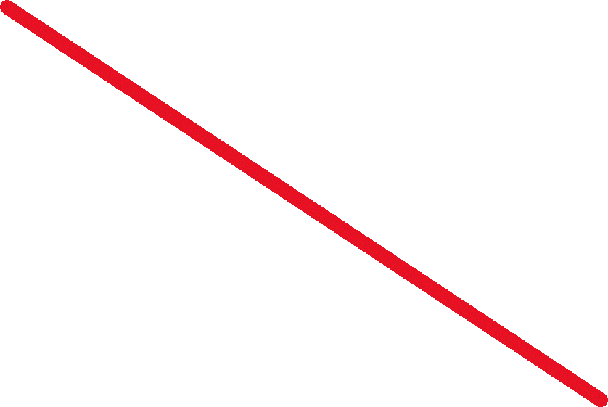
Early Days
1

Slide 12
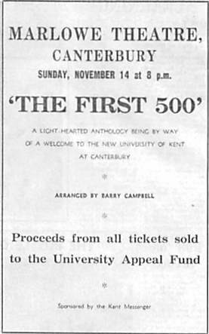
The ‘First 500’ arrived at Eliot in 1965
  But they only really numbered about 400-450
  And they were not the first (research postgrads had arrived with staff)
The name is associated with a fundraising play put on at the Marlowe Theatre
The play was Sir Thomas More, premiered around 1592
Shakespeare may have contributed, but there were many contributors and no single author
It is notable for 59 speaking parts, of which 22 appear in the first 500 lines of the play
However, the name of this production was clearly aimed at publicising the University
2

Slide 13
At this time, there was no central hall, performance space, Students’ Union, or any other large space
Eliot Hall had to suffice
This was due to lack of money (the University’s initial fundraising had raised only about 50% of its target)
There were some monetary distractions around this time
  Councils spent funds on activities surrounding Winston Churchill’s funeral
  Local government reorganisation had reduced the number of income sources, and diverted money as well
Had there been a central hall, Lord Holford wanted it to be near Eliot College (ironically, where the Venue was eventually built)
For some years, the Sports Hall was pressed into service for very large events
1

Slide 14
The Colleges
Holford’s plan was for ten colleges, but this did not happen
Money ran out after the first three, but a fourth was built on a reduced budget
The names are interesting:
  TS Eliot died in 1965 (Humanities), Rutherford (Science), Keynes (Social Science)
  Darwin was a bit of a tussle; Bertrand Russell had just died, but Bryan Keith-Lucas, the founding Master of College ‘D’ (as it was known) disagreed strongly (and so did others)
    Russell had insulted Bryan’s father
    Charles Darwin’s son (Sir Horace Darwin) raised funds to support Bryan and his siblings after their father (Keith Lucas) died
The later alternative to Colleges was a ‘housing estate’, i.e. Park Wood
  This could be sold or rented if the University got into financial difficulty
Eventually, of course, Woolf and Turing were built
3

Slide 15
Arrival and Darwin
Bob arrived on 3rd October 1970, lodging with Derek Butler’s mother-in-law
  He later spent six years living in a Darwin student room
First event was a speech from the Master, Bryan Keith-Lucas
Random facts:
  On arrival, Darwin wasn’t entirely finished, although nothing serious
  Architecture was a departure from the previous brutalist style
  Poor drainage in the corner of campus, and pumps to keep the cellar dry
  Shared bar to encourage staff/student interaction
  Direct access to the Master via a side door
  There is an original tile kiln in the garden between the College and Hackington Road
1

Slide 16
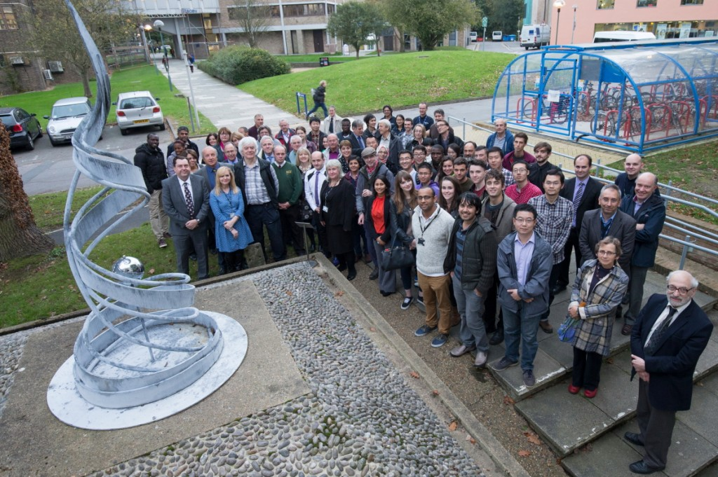
Electronics (Jennison)
Bob arrived to study Electronics, although the building wasn’t finished until Christmas (when the labs opened). One part wasn’t finished for over 40 years; the top of a small plant room at the front of the building, which was modelled as a plinth for an (initially non-existent) statue or similar
Roger Jennison had a couple of designs, and one of them made it as far as a substantial model, showing three standing figures (Newton, Planck and Einstein) looking down on a fourth (there may have been a plot to make it a likeness of Jennison)
In the event, an abstract sculpture was placed there (Synapse-Soleil), 44 years after the plinth was laid
1

Slide 17
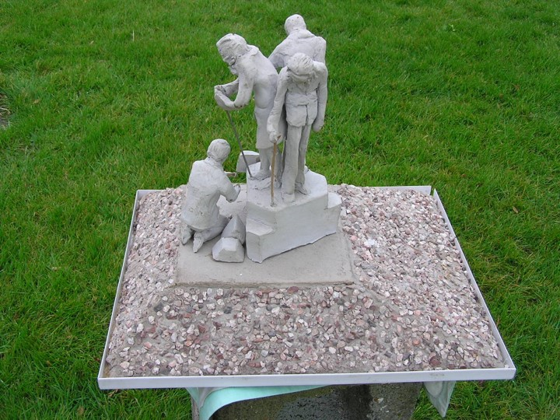
Model of the Jennison idea

Slide 18
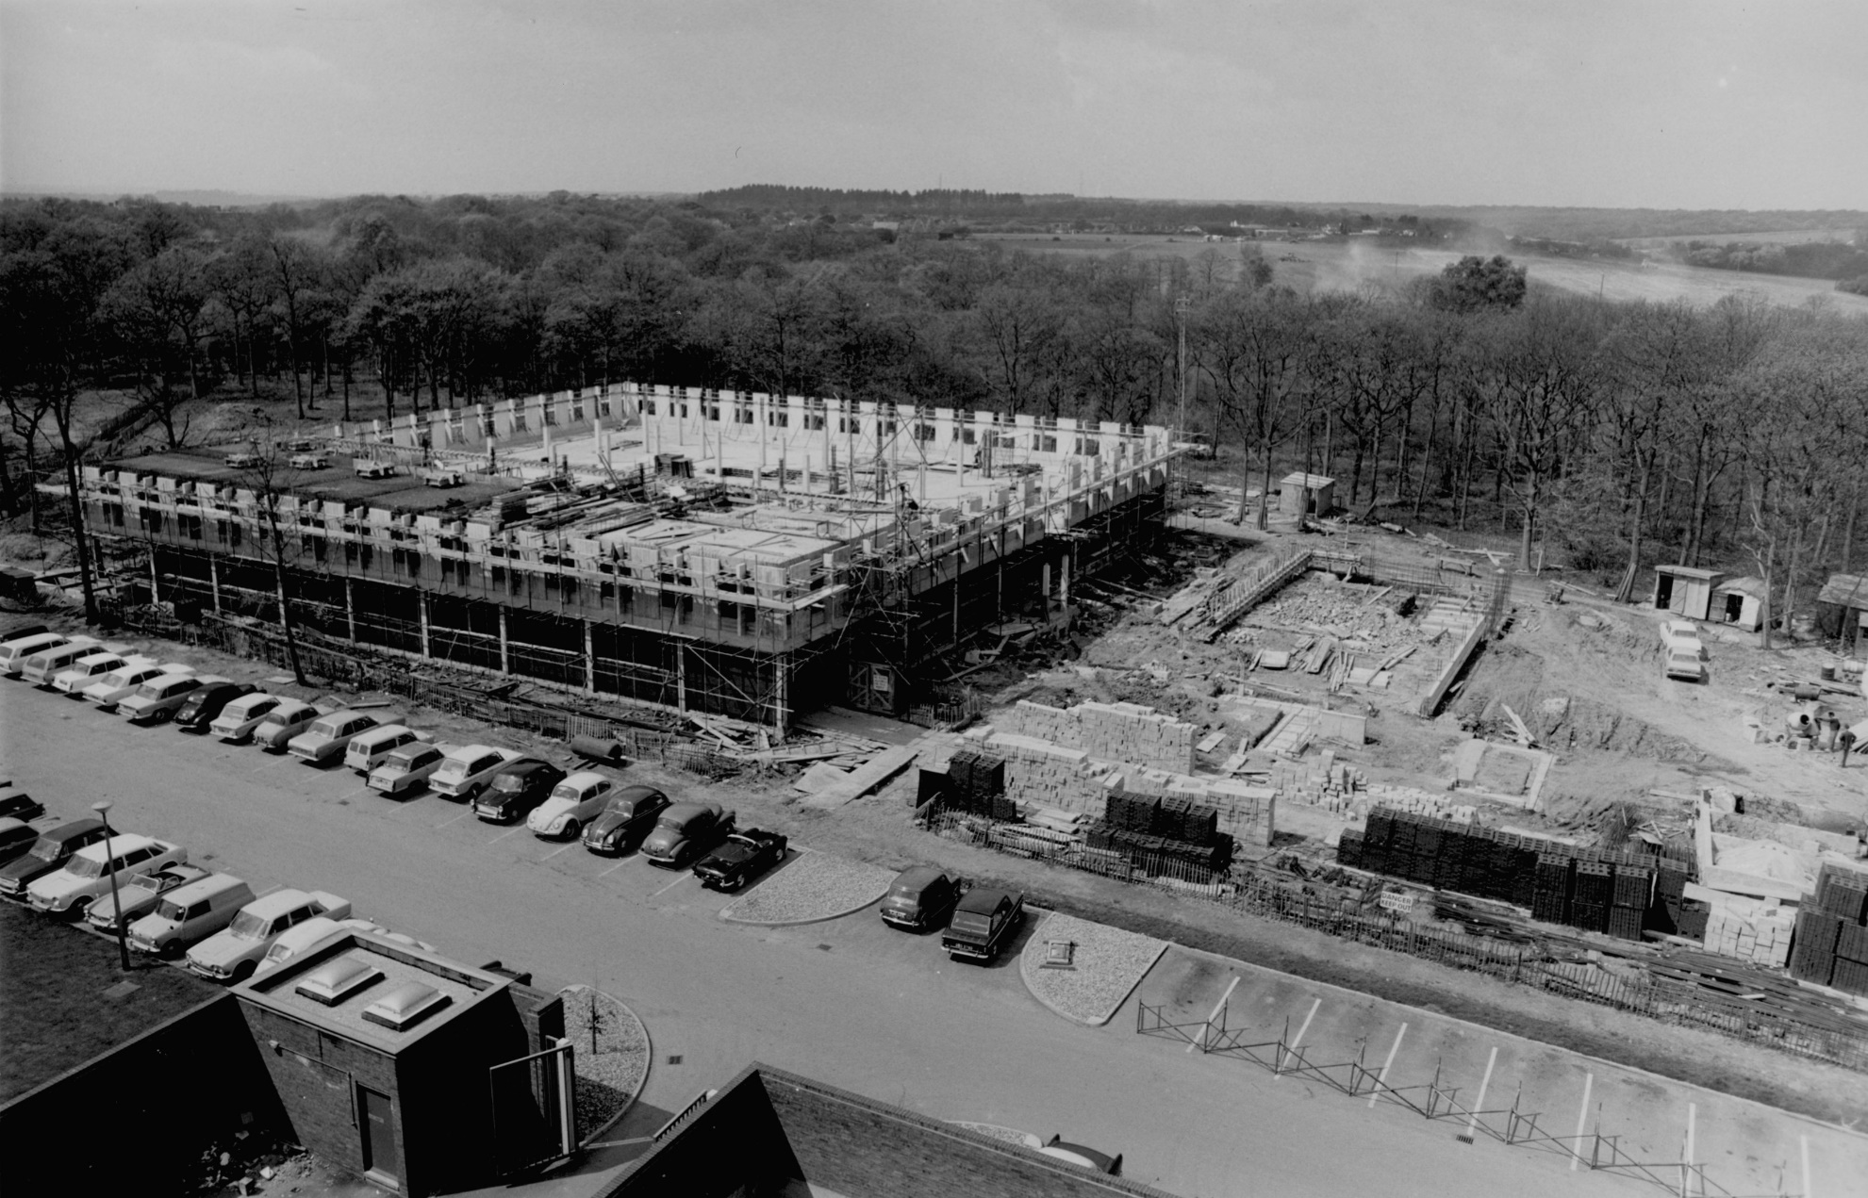
Electronics building under construction (spring 1970?)

Slide 19
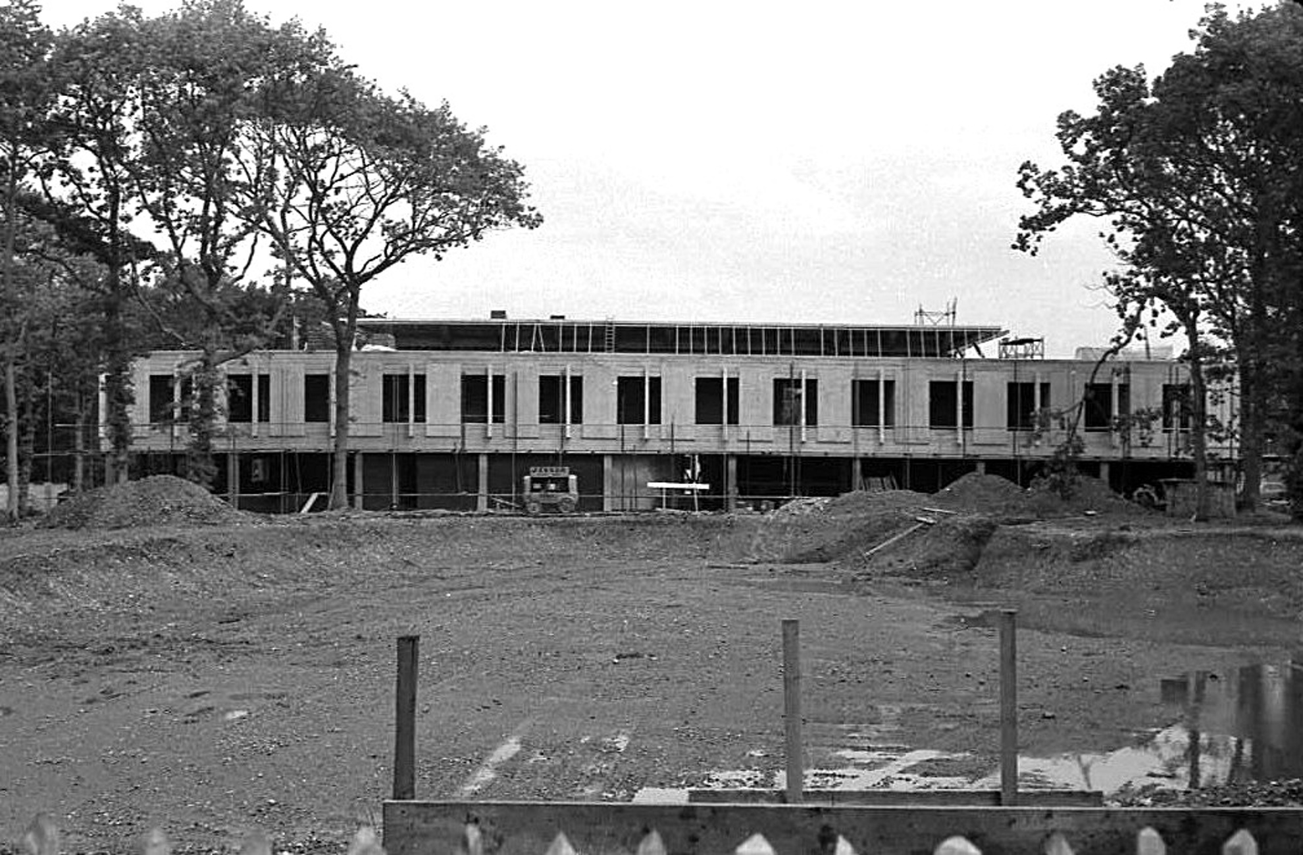
Excavations for the Electronics pond (no, it isn’t natural!)

Slide 20
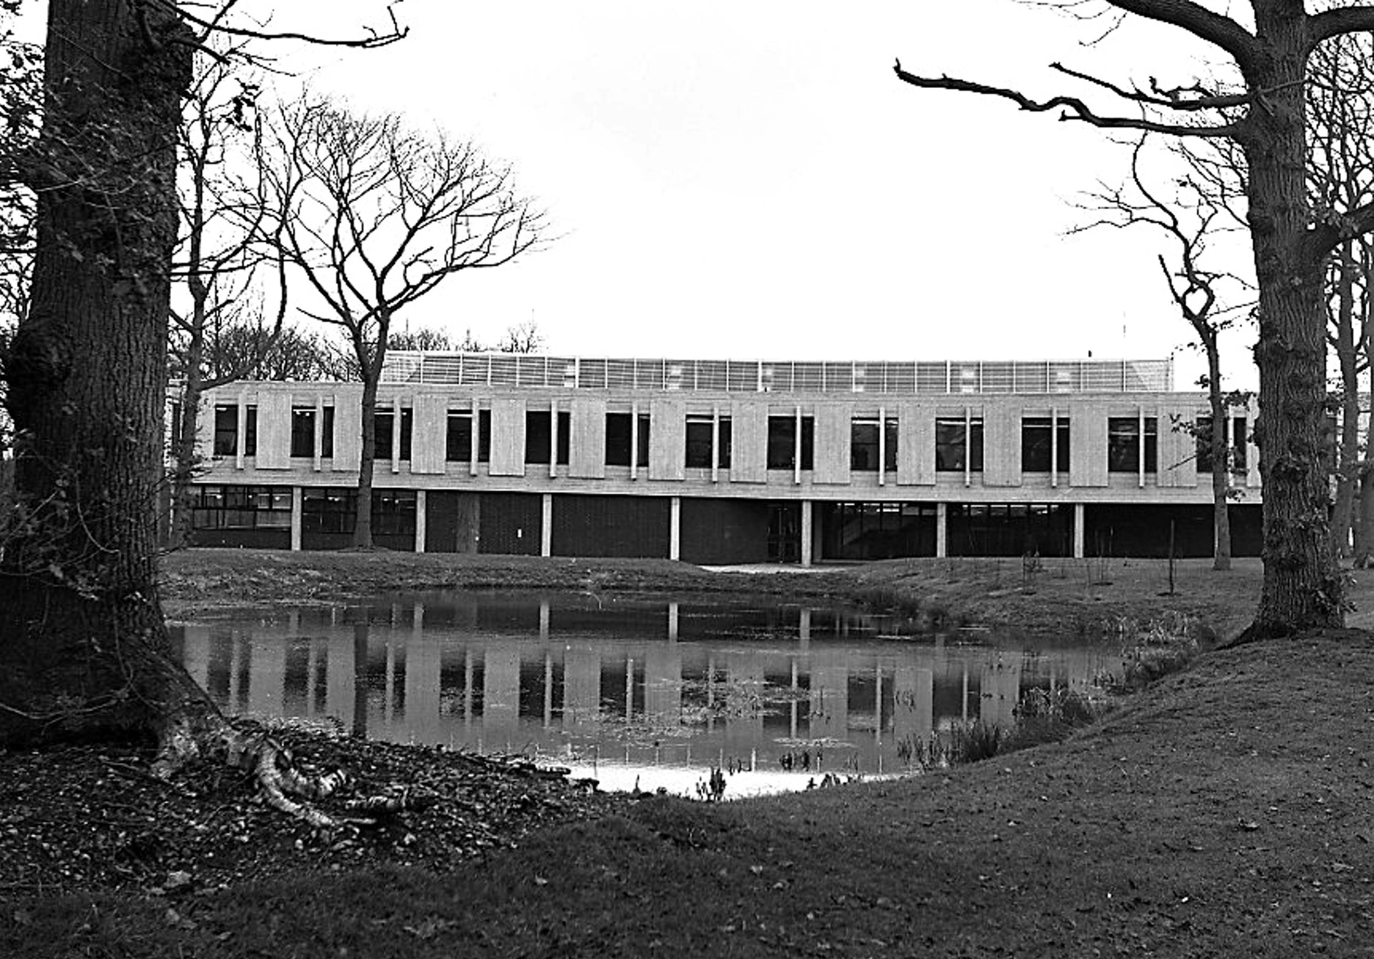
The pond, now filled; allegedly for a Lloyds mirror interferometer (together with the structure which was to go on the roof). A good pretext.

Slide 21
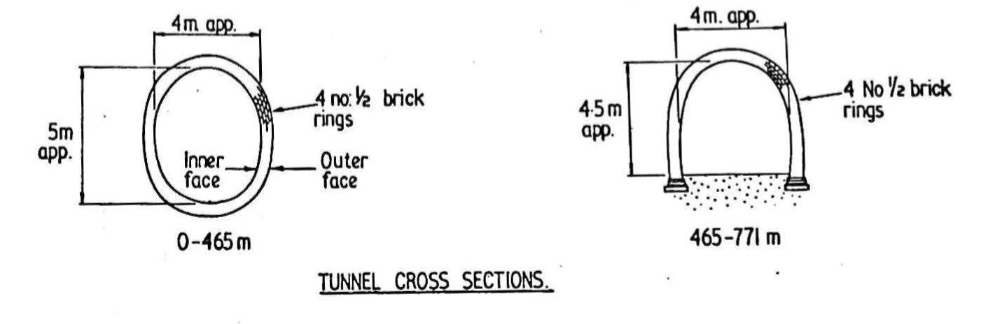
The Tunnel
The famous railway tunnel was constructed as part of the Canterbury to Whitstable railway (the “Crab and Winkle Line”)
The tunnel was dug from both ends, and the two excavations met in May 1827; there had been some problems as the ground was unstable in places; it is now clear that poor quality bricks were used in places, and the work was rushed
2.4 million bricks were used for the lining (four bricks deep) with 6 feet (6000 bricks) being constructed every 24 hours (dig at night, brick by day)
British Railways sold the tunnel to the University in 1963, and they took over responsibility for it, continuing to inspect it regularly

Slide 22
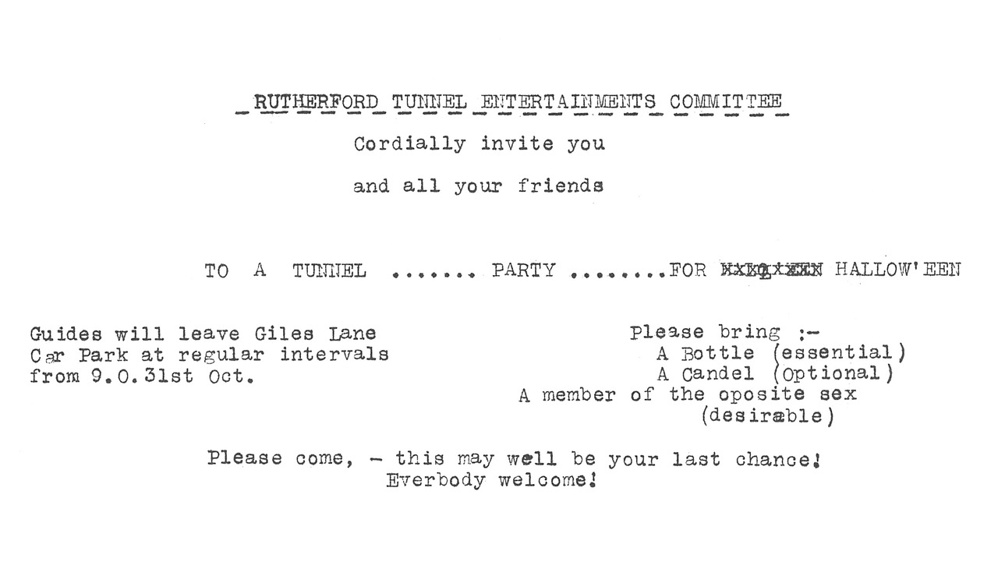
The northern portion of the tunnel (as far south as Rutherford College, roughly) was in London clay, which was generally stable (!!!)
The southern portion was in sand, and used a different construction
The railway line was closed in 1952 (but reopened briefly during the 1953 flooding) and had since been closed and mostly sealed
  This reduced ventilation and increased damp
It was a common student activity to walk through the tunnel (Bob has done this) as the barriers never lasted for long; there were also parties, despite the danger
2

Slide 23
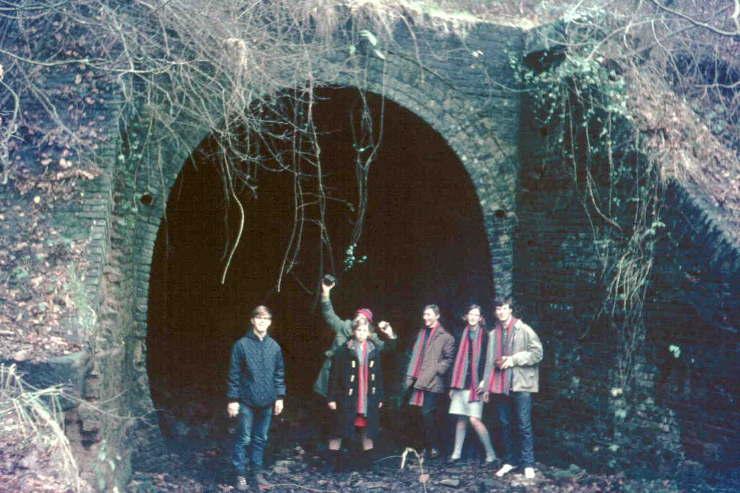
A group of students after a tunnel trip, at the north portal (near Woolf College today)

Slide 24
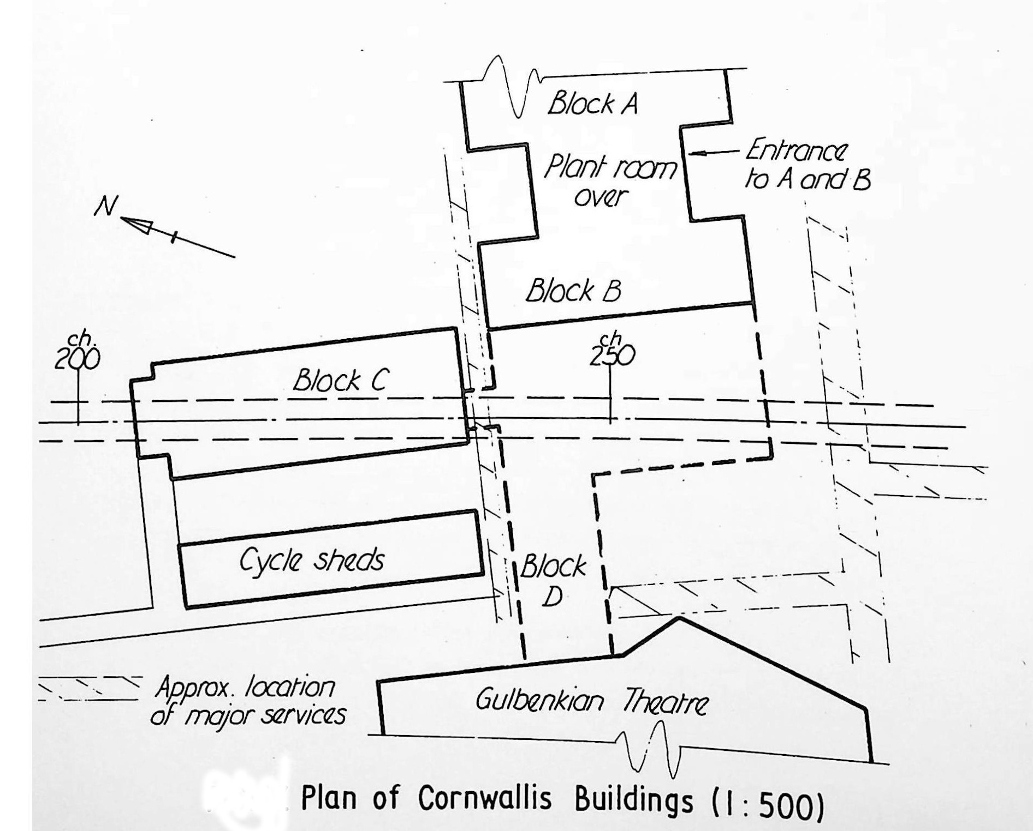
The location of the tunnel should be clear from this diagram

Slide 25
It was known that the tunnel was potentially unstable, and in fact the University had already engaged contractors; it is hard to find fault with the University, and no one was killed or injured
There had been clay ingress on the 3rd July and 10th July 1974
The mechanism of any collapse was expected to be gradual – but it wasn’t
Three members of University staff were very nearly caught in the major fall in the afternoon of 11th July; there were low rumblings from the area of collapse, and three “loud reports” from the bridge linking Cornwallis and the Gulbenkian
At 9 p.m. that day, the building began to settle, and within an hour or so the movement ceased; on the following morning, Block B and Block D (the link bridge) were noted to have sunk by about 700mm (2ft 3½in)
It was later found that Block C was almost unaffected, and it stands to this day
There was danger to the plant room on the roof of Block B, but it was saved
1

Slide 26
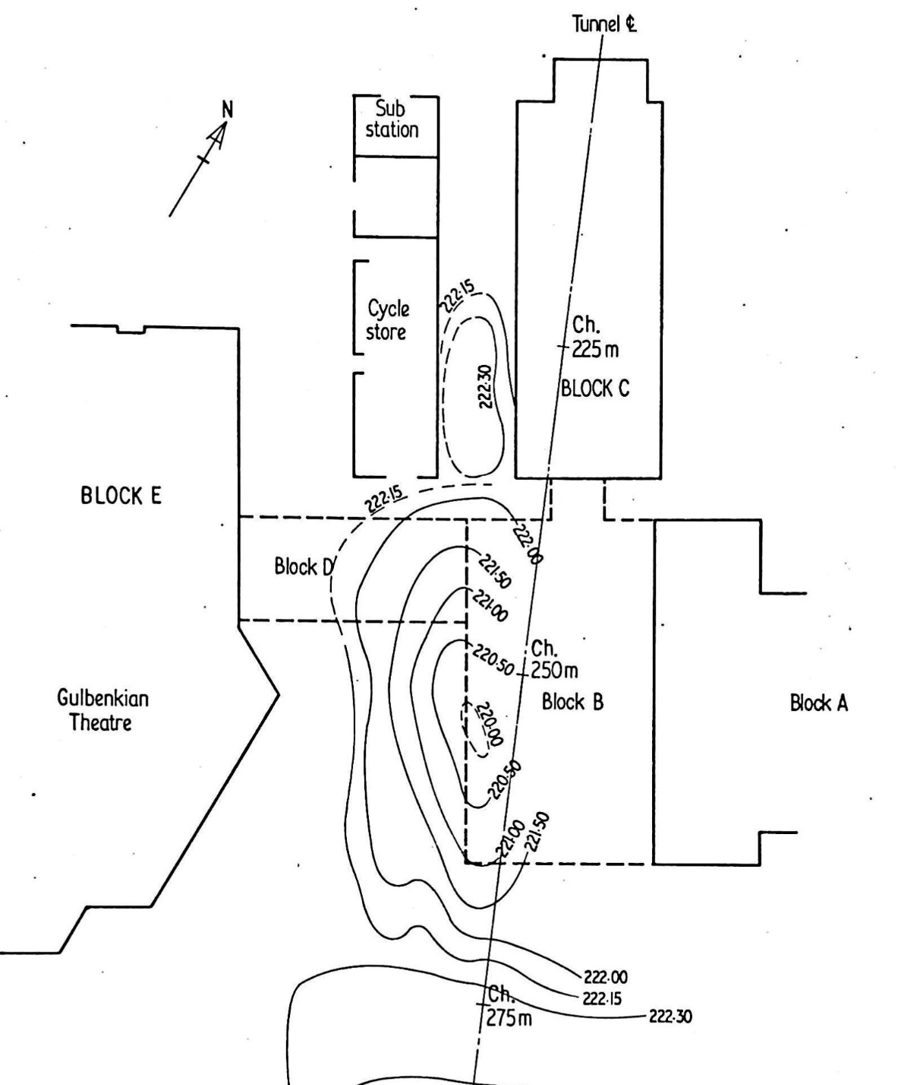
Contours of the sunken part of the tunnel, at the surface
The depression was about 2 metres deep, and covered the whole of the west side of Block B
(the numbers preceded by ‘Ch’ are the distance (chainage) in metres from the northern portal of the tunnel, behind Giles Lane car park)
Block D of course sank, and was quickly demolished to reduce damage to Block E

Slide 27
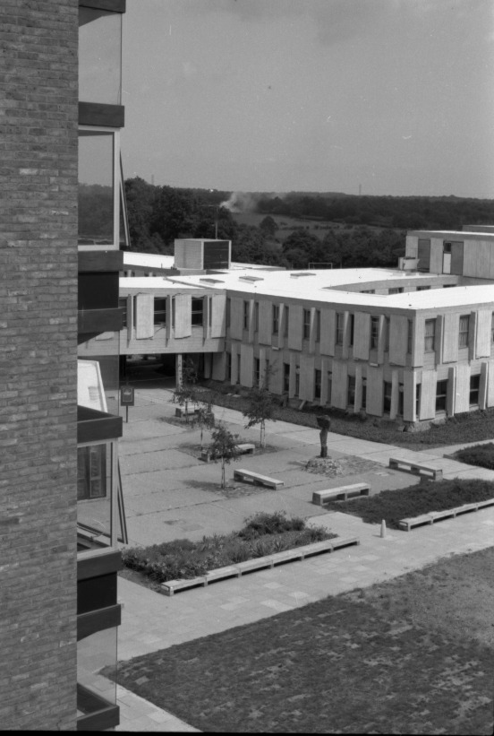
The link bridge (Block D) can be seen to have dropped; the area has been cleared
It is not so obvious that Block B has dropped, and it is hard to see the depression in the ground at this point

Slide 28
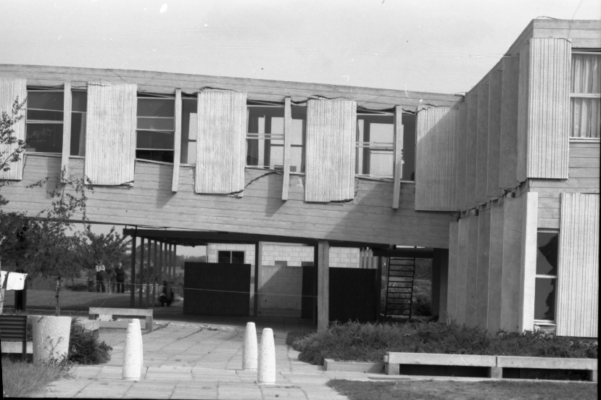
Another view of the link bridge. Note the large cracks, and the distorted windows. The sunken ground is more apparent here.

Slide 29
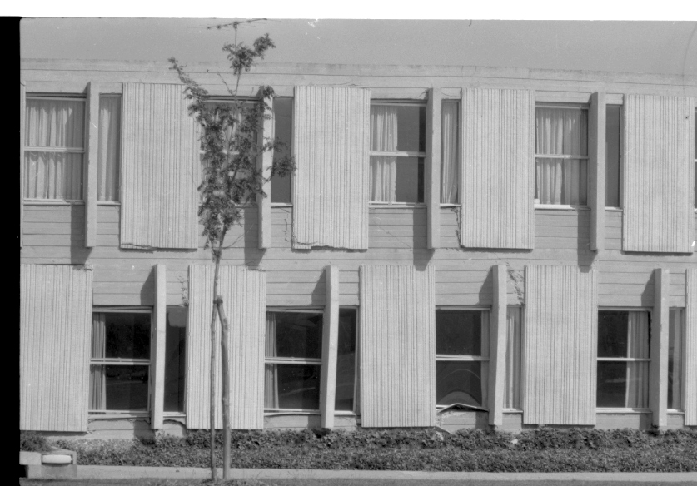
South side of Block B. The building broke its back roughly at the point of the red arrow

Slide 30
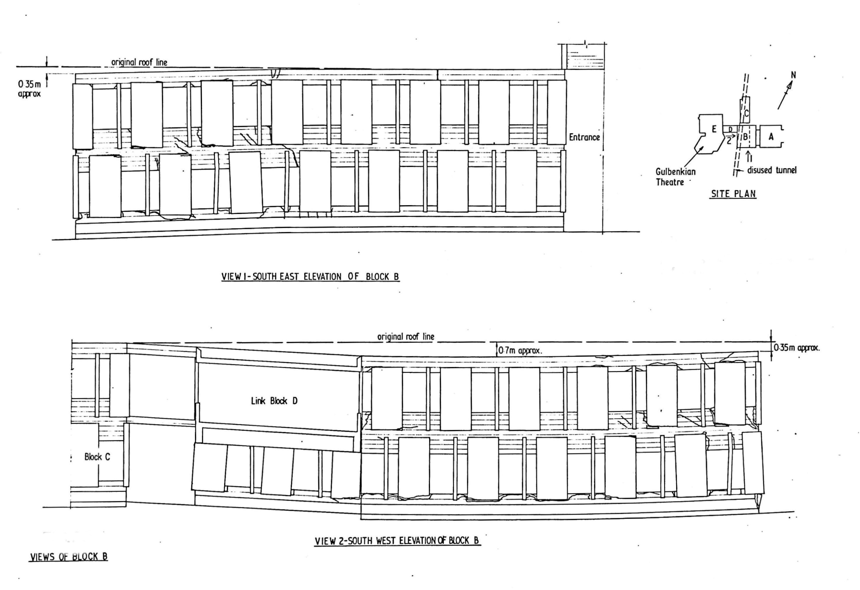

Slide 31
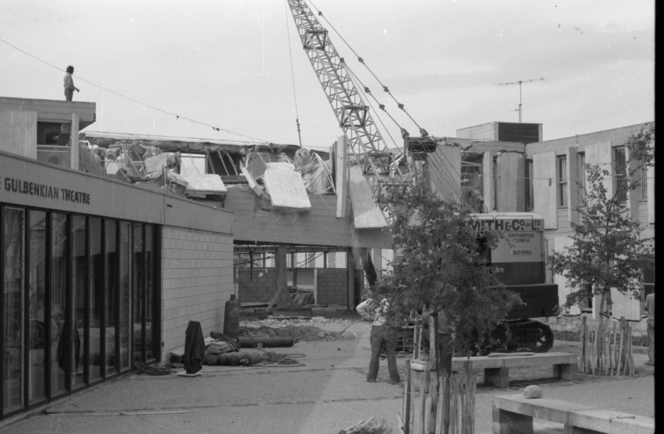
Hasty demolition of Block D, to save the Gulbenkian Theatre

Slide 32
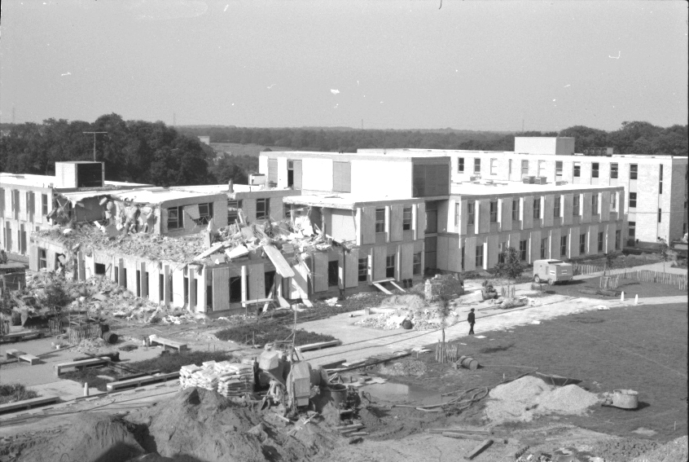
Demolition of (most of) Block B. Note the threatened plant room on the roof

Slide 33
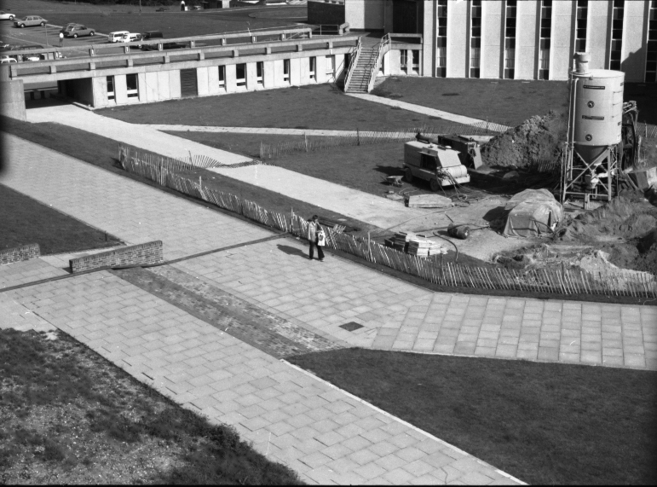
Separate operation to stabilize Rutherford (and waste outfalls further down) by pumping PFA (Pulverised Fuel Ash and cement) into the tunnel

Slide 34
Why did it happen?
There was no real negligence; there were regular checks, and action was being taken, but the failure was fast
The invert (bottom arch of the oval) had failed, and clay was gradually entering the tunnel; this accelerated, leaving a void into which more clay fell
This left a void above the tunnel, with a smooth clay plug up to the surface
The clay plug suddenly dropped, leaving a void at the surface
Block B partially separated from its foundations …
… and the rest is history!

Slide 35
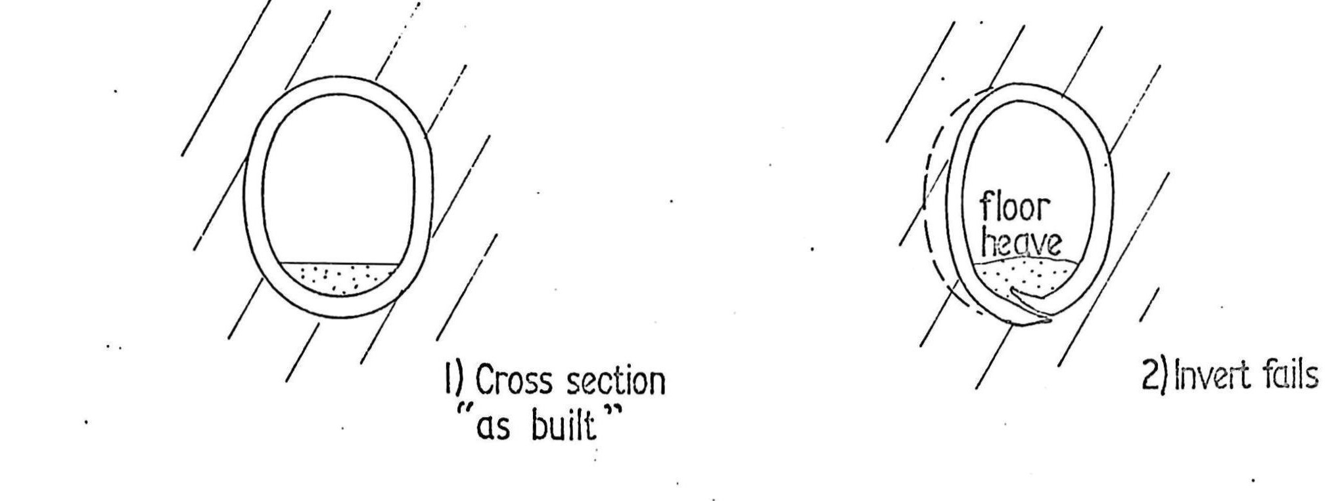

Slide 36
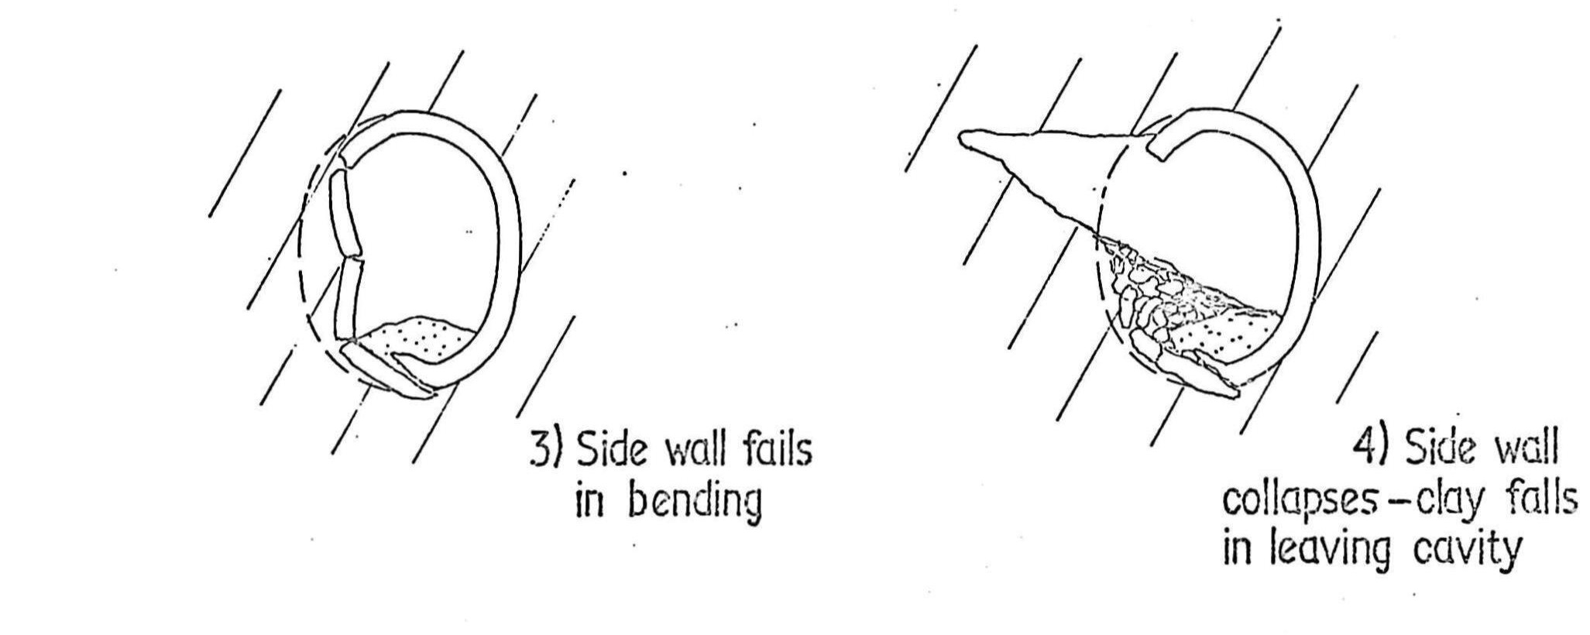

Slide 37
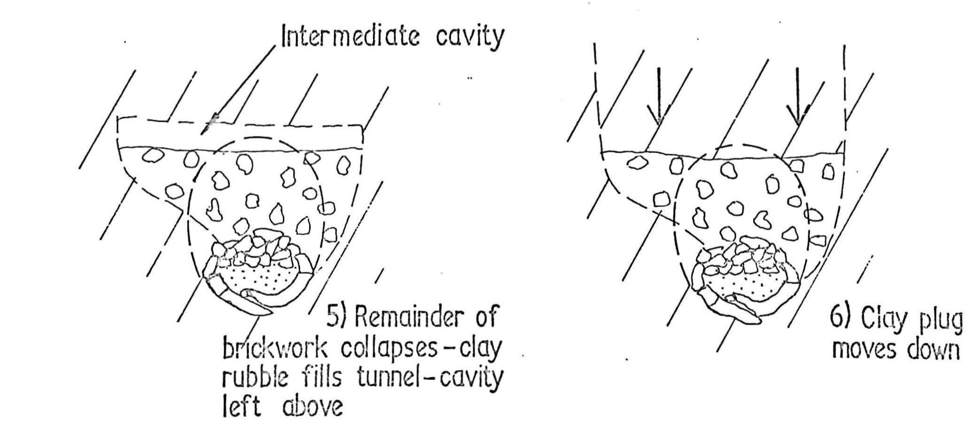

Slide 38
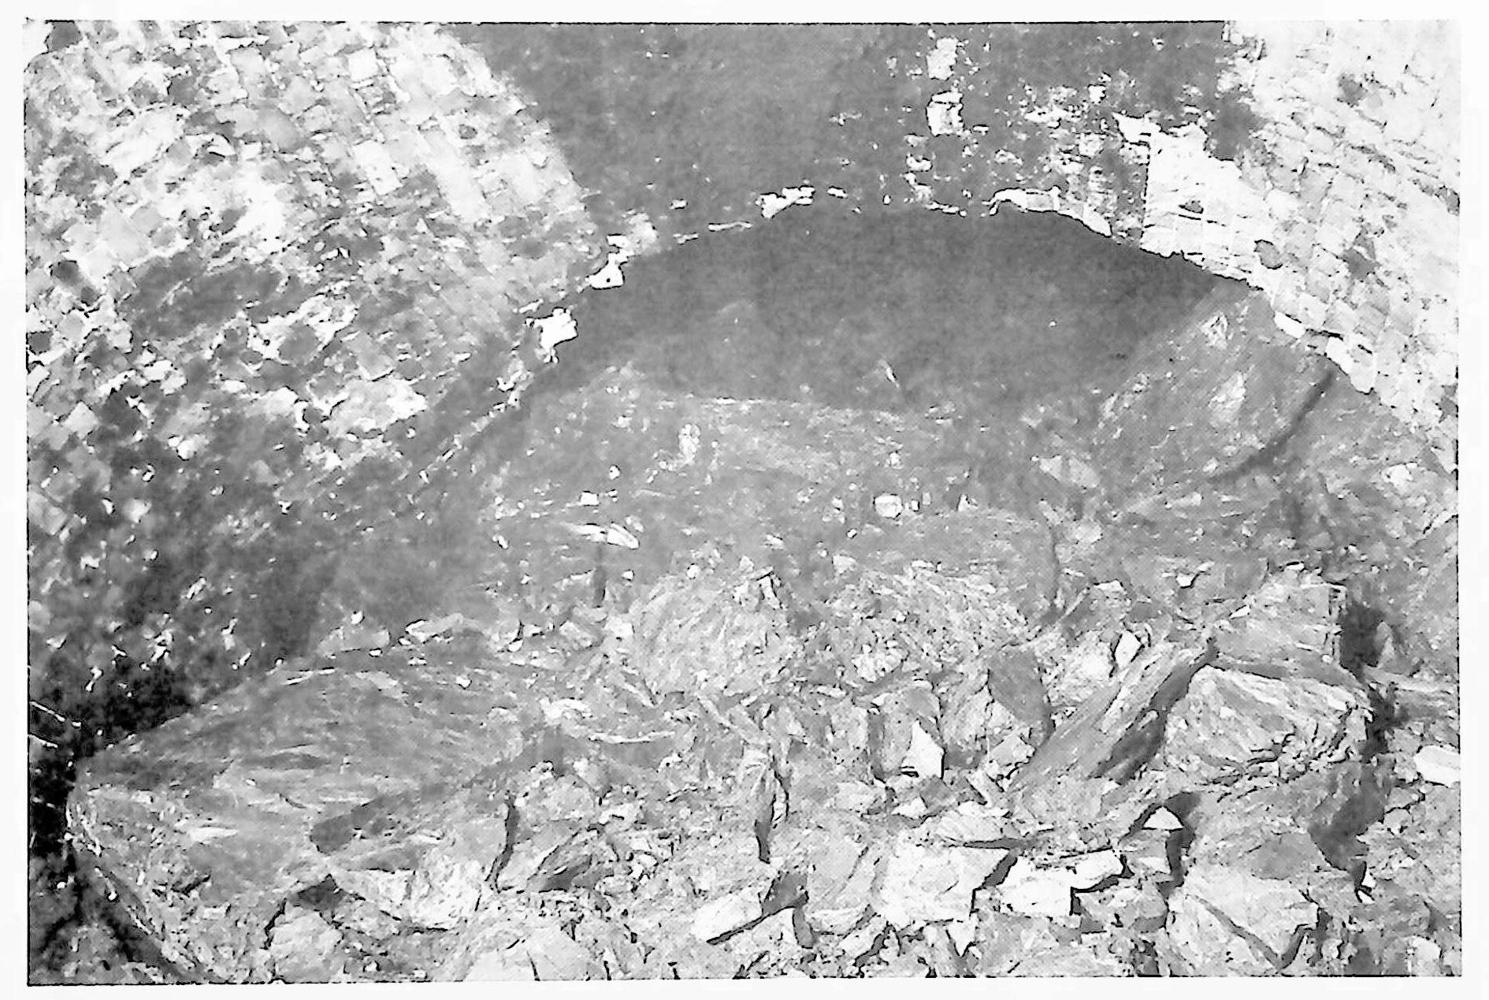
Clay fall above breach – 9th July 1974

Slide 39
Tunnel Aftermath
  Power and other services had to be rerouted (cables were next to Blocks C and D)
    There was a small substation nearby
  The University computer was moved from the western end of Block A, to the only other air-conditioned area, at the eastern end
    This was cramped but manageable
    It was moved back in 1975-76, in time for a new computer anyway
  Monitoring for cracks was set up in the Cornwallis building and in Rutherford College
    Glass tubes fixed across existing cracks to give early warning

Slide 40
The Present
  Engineers were careful to stabilize stresses in the clay in both horizontal and vertical directions
  They were confident that there were no other problems
  If any building were to take place further down the hill, on the line of the tunnel, then that would require more filling with PFA or similar
  It was recommended that the portion of the tunnel crossing surface and foul water sewers be filled, but it is unclear if this was done
  After about 15 years with no significant movement, the Cornwallis South West wing was built, straddling the tunnel
  The link bridge was also rebuilt
  The Footsteps path closely follows the line of the tunnel between Cornwallis and the vicinity of Senate
THE END
1

Slide 41
Ackowledgements
  Thanks are due to the following:
    The University of Kent
    Jamie Angus-Whiteoak
    Peter Brown
    Derek Butler
    Richard Collier
    Chris Dawson
    Paddy Farrell
    Ray Glover
    Tony McDonnell
    Ian McWhirter
    Ted Parker
    Mohamed Sobhy
  There are no doubt others that I have forgotten, and I apologise to them!

Slide 42
References
  There are many references, and most of them are accessible on the Internet
  Rather than provide links here (which would be tedious to use), I have set up a web page containing links to references, as well as other supporting material
  The web page is here:
  http://ukcmove.bobeager.uk
X

